Slide 1
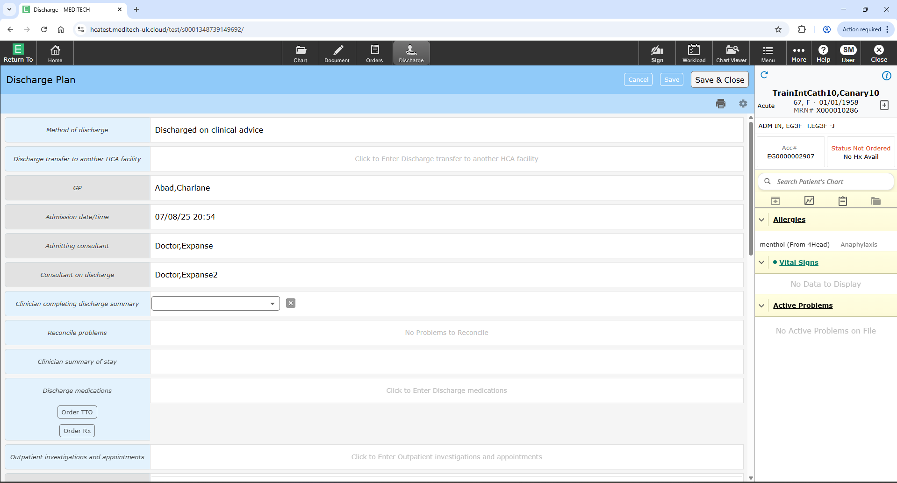
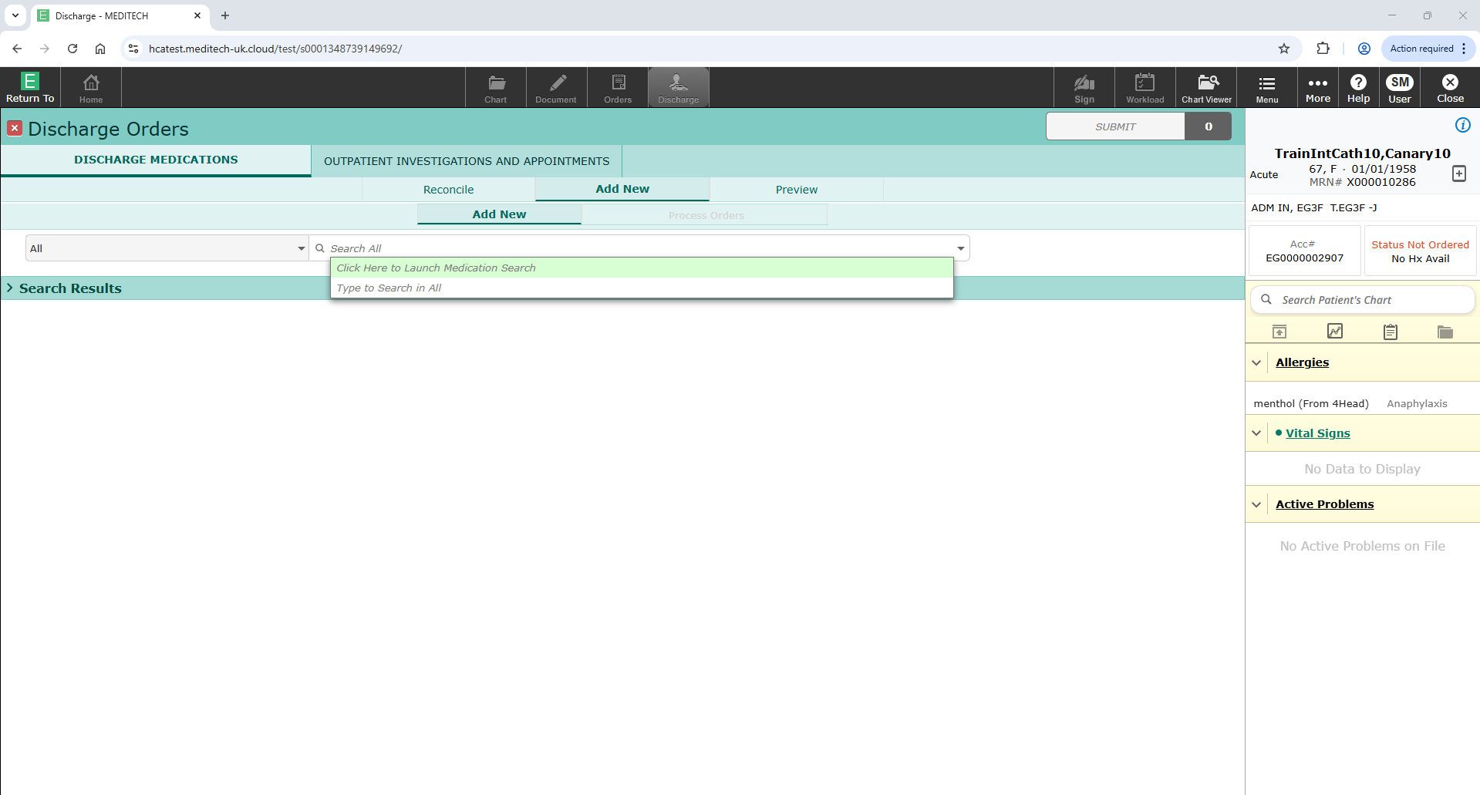
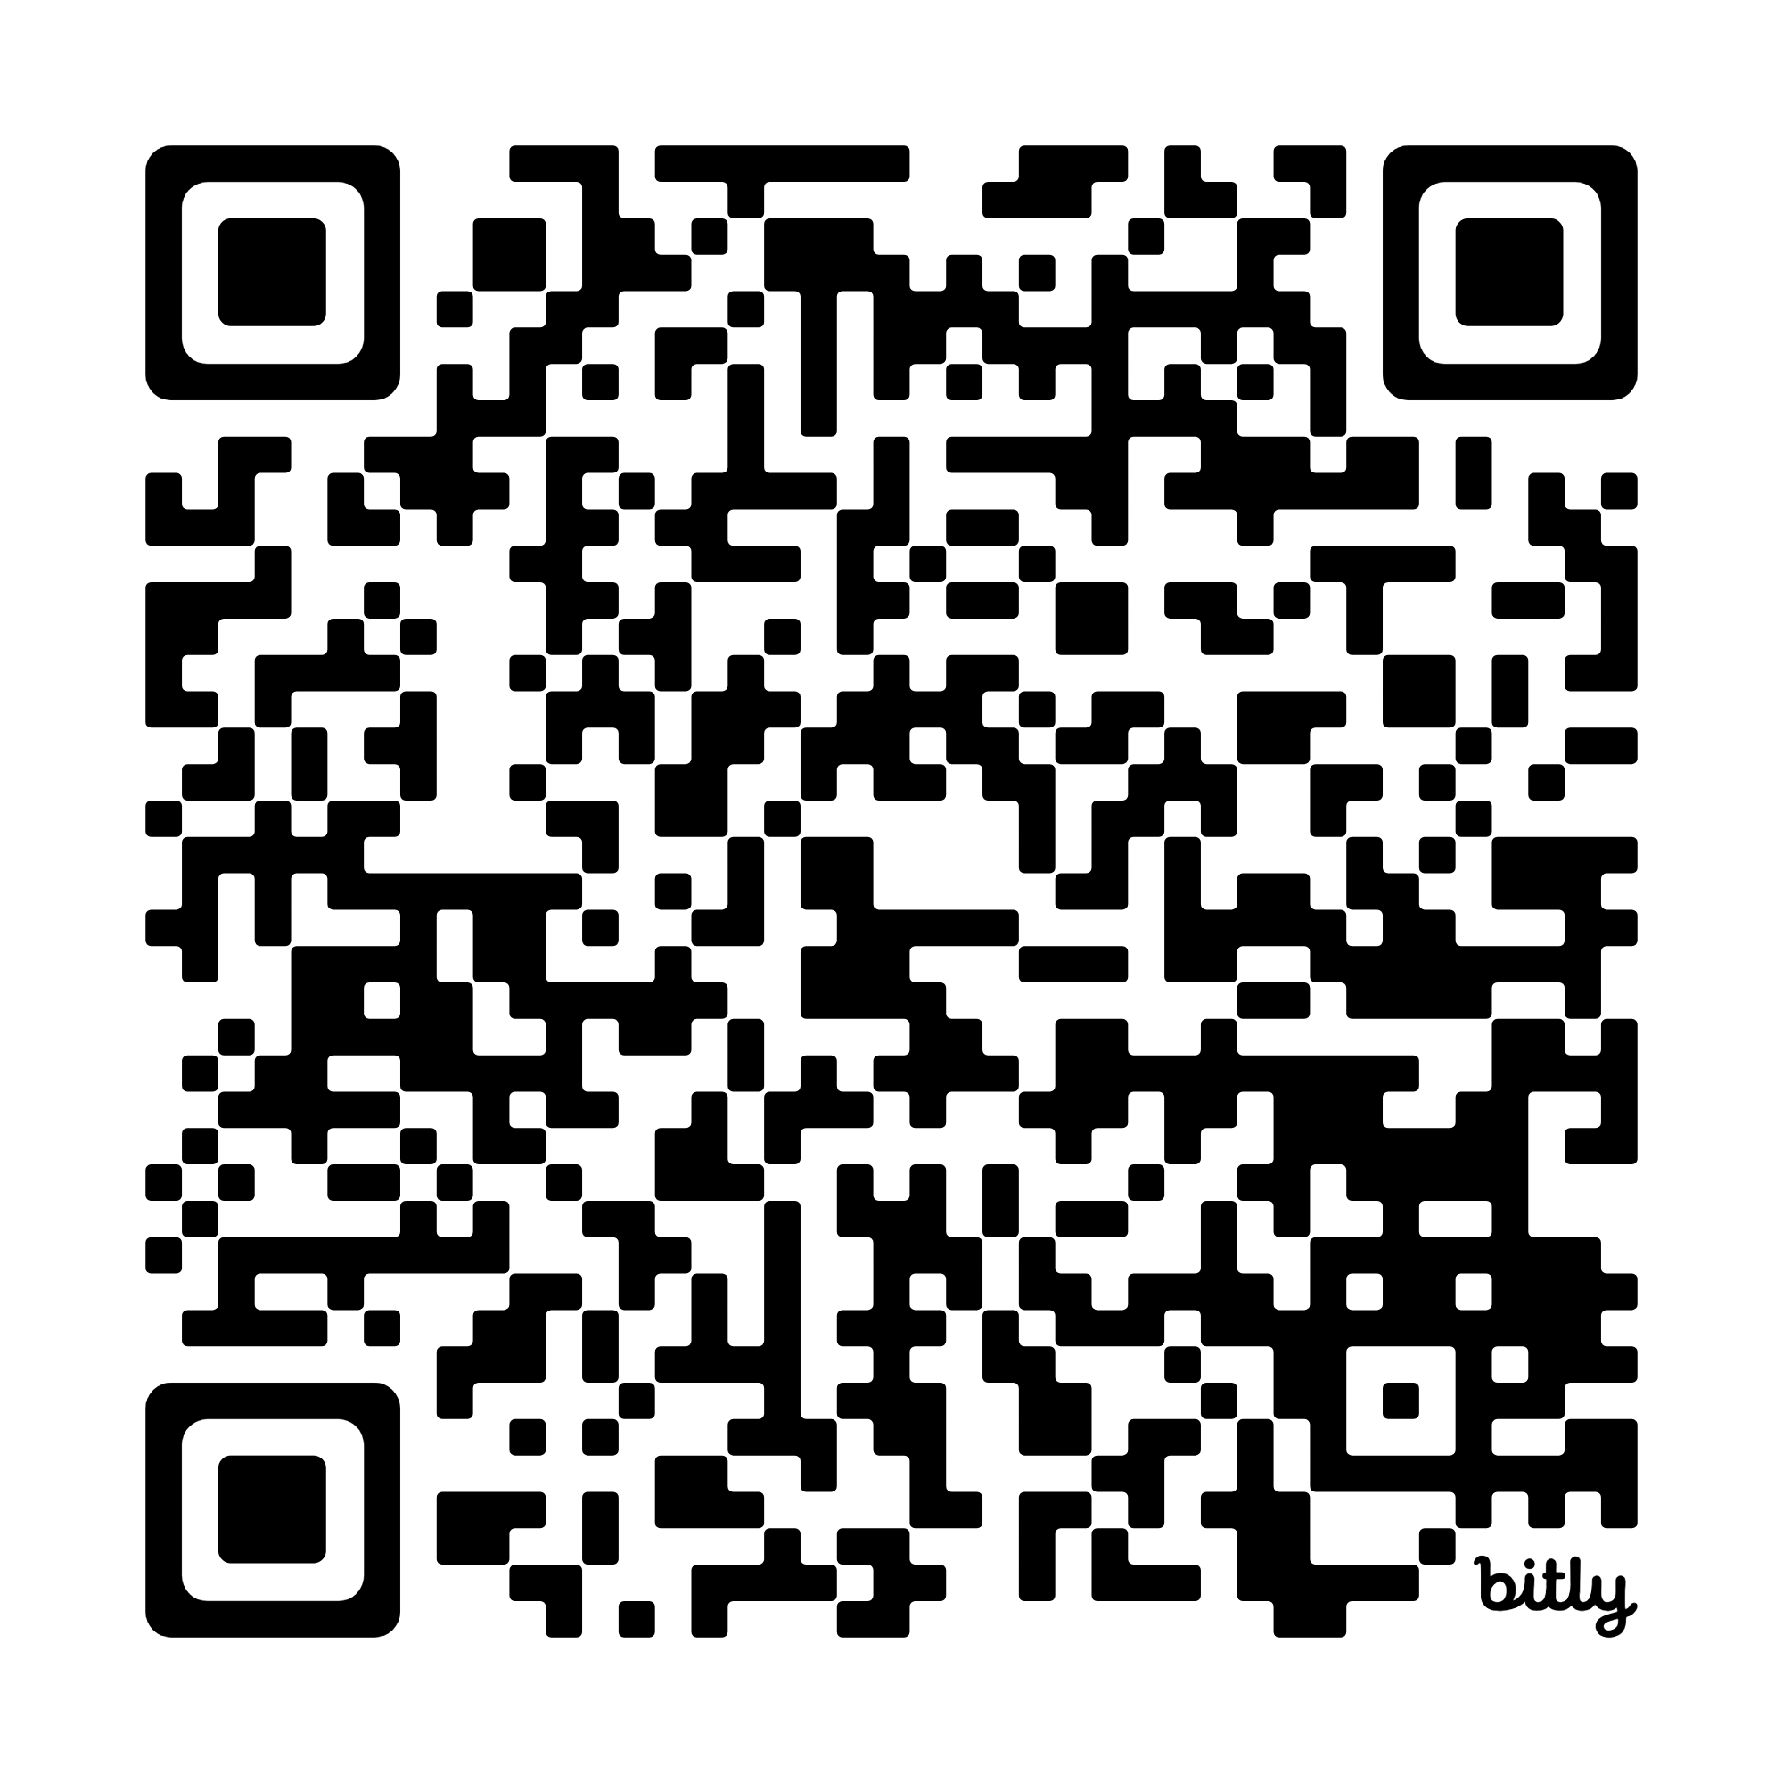
Home
Writing (ordering) TTOS and the discharge summary
Click to return to menu page
Select the discharge icon at the top of the patient record to open the discharge page
Complete the relevant sections, usually “clinician summary of stay”
To complete the TTOs, select Order TTO
You will have the option to “Reconcile”, “Add new”, or “Preview” the TTO
Reconcile when the patient has drugs prescribed on their MAR
Add new when you want the patient to go home with drugs that are not on the MAR
Go to 55:56

