Slide 1

Elective caesarean section workflow
20th October 2025

Slide 2
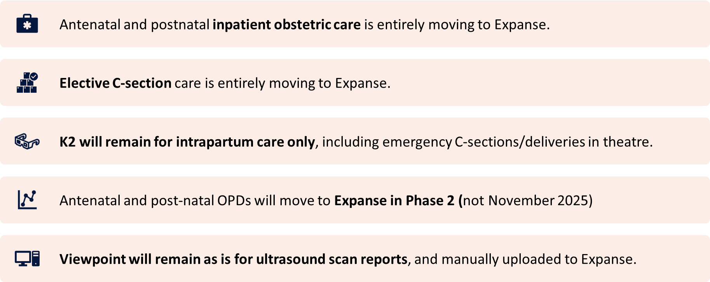
High level changes for Obstetricians

Slide 3
Overview
Pre-operative
See patient on ward
Check blood results on Expanse and paper consent form
Intra-operative
Pre-operative checklists (documented by theatre team)
Document caesarean section:
Obs Caesarean Section
Post-operative
Review patient on postnatal ward
Document post-natal review:
Obs Postnatal Review
Document pre-operative review:
Obstetrics Inpatient Note
Order blood tests and medications
Perform caesarean section
*Either Anaesthetic Assessment" or "Anaesthetic Note" PDOC can be used

Slide 4
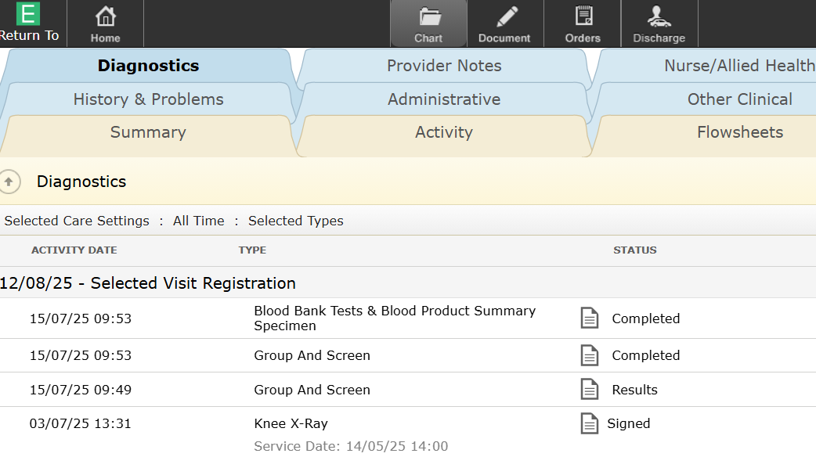
Checking blood results
1) Click “Chart”
2) Select the “Diagnostics” tab
3) Click here to view results

Slide 5
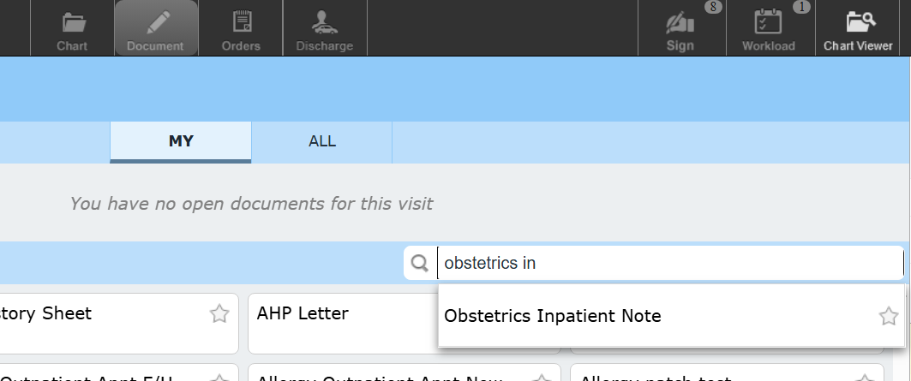
Document pre-operative review
1) Click “Document”
2) Search for “Obstetrics in…”
3) Click the  to favourite, and select the document

Slide 6
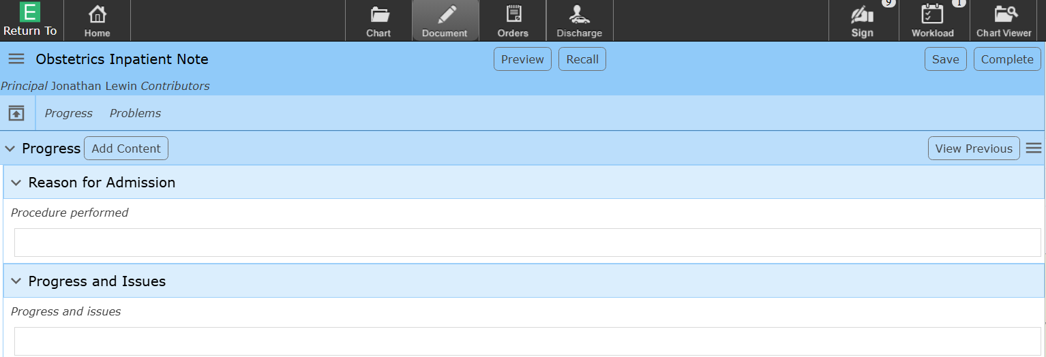
Document pre-operative review
1) Click “Progress” to open the documentation section
2) Leave this section blank, so that it does not show in the final document
4) Click “complete” to sign the document
3) Click in this box and type to document your review

Slide 7
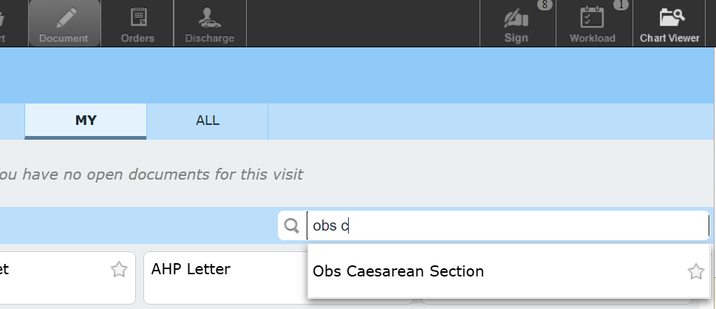
Document caesarean section (op note)
1) Click “Document”
2) Type “Obs C..” to search
3) Favourite and select the document

Slide 8
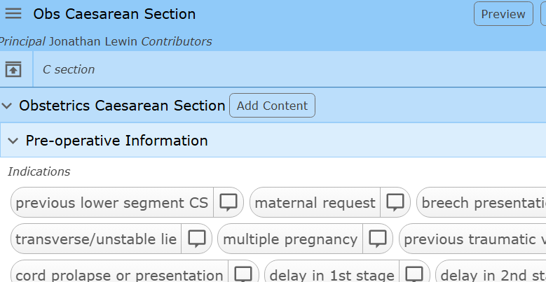
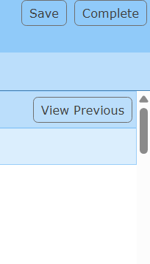
Document caesarean section (op note)
1) Click “Obstetrics Caesarean Section” to open the documentation sections
2) Select buttons and enter free text as required
3) Click “Complete” to sign

Slide 9
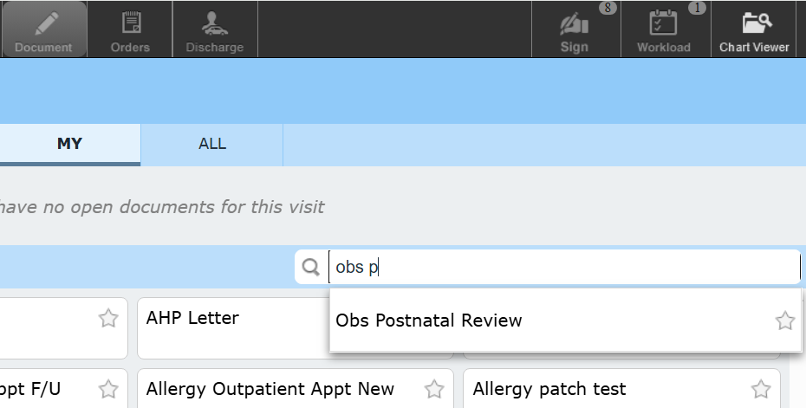
Document caesarean section (op note)
1) Click “Document”
2) Type “Obs P..” to search
3) Favourite and select the document

Slide 10
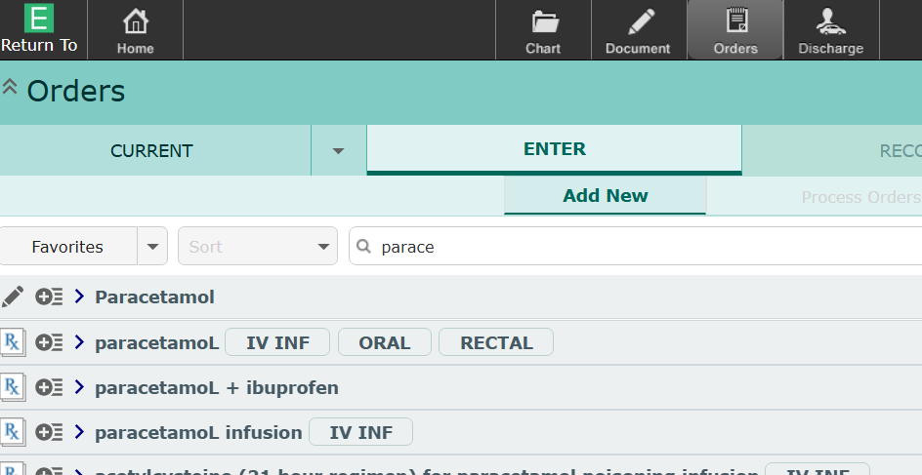
Prescribe medications and order bloods
Click “Orders”
2) Search for the drug or test

