Slide 1



Medicine & Radiology Cheat Sheets
Getting Started
    Logging in
    Remote access
    Changing your PIN
Navigating patient home page
    Finding your patient from ward list
    Finding your patient from their details
    Special indicators
Documenting
    Selecting the right document
    Documents for medical specialties
    Cardiology documenting
    Radiology documenting and workflow
    Adding your entry: adding an active problem
    Adding your entry: adding documentation to sections
    Quick text
    Reviewing results
    Reviewing the drug chart
    Reviewing existing notes
Ordering
    Prescribing (ordering) drugs
    Requesting (ordering) investigations
    Prescribing (ordering) transfusion
    Completing (ordering) resus status
    Writing (ordering) TTOs & the discharge summary
    Completing a TTO for a controlled drug

Slide 2
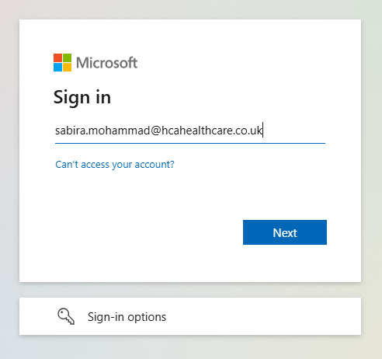
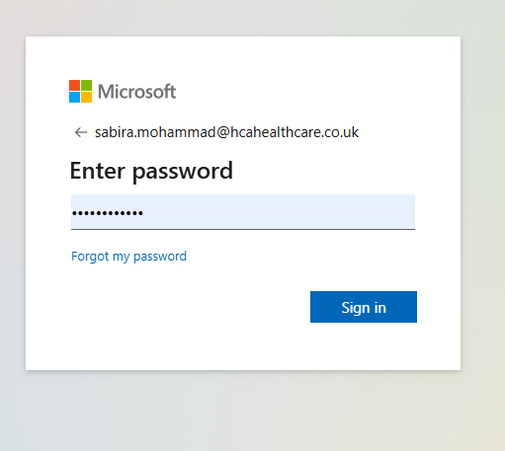

Home
Logging in
Click to return to menu page
On your desktop, double click on the Meditech Expanse icon
Type in your username
Username is your HCA email address
Type in your password
Password is the same as the password you used to log into Windows on a HCA computer
Click launch session
If you do not have you HCA email, then please call the IT help desk on: call the IT Service Desk - 0207 759 3737 (internally 23737) & select options 1 and 1 again.
Cheat tip! Anyone with access to their HCA Teams or Outlook can look up your email address

Slide 3
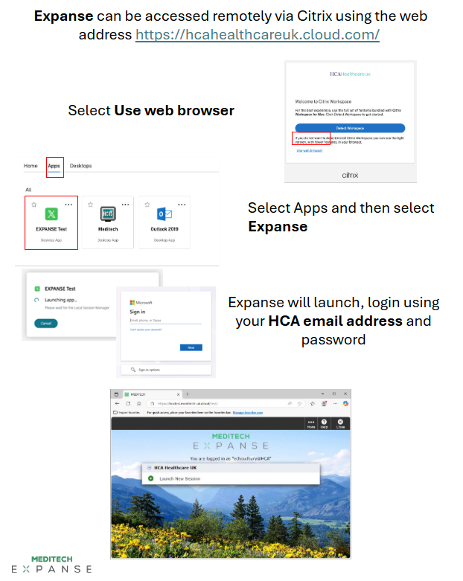
Home
Remote access
Click to return to menu page

Slide 4
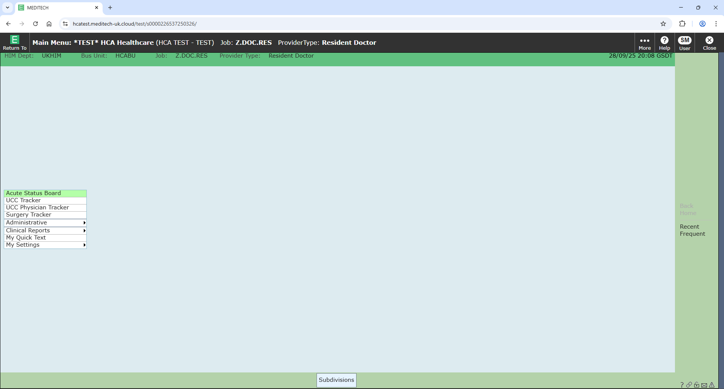
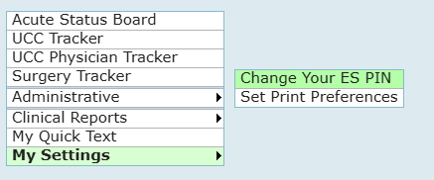
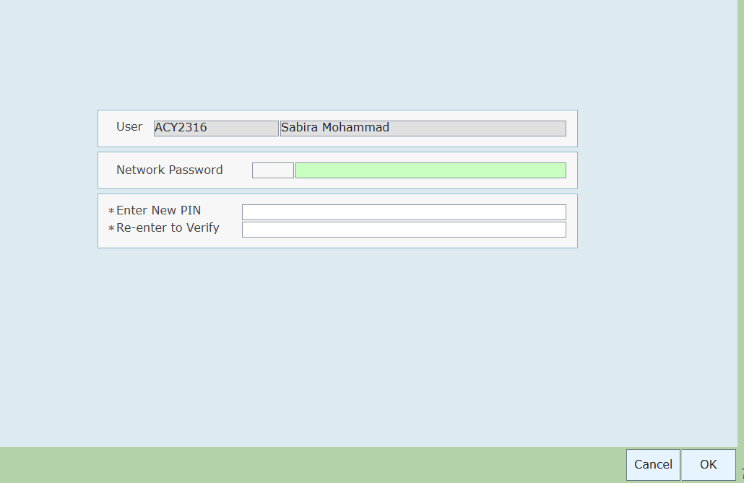
Home
Changing your PIN
Click to return to menu page
On your home page, select “My settings”, the last option on the list
Select “Change Your ES PIN”
Enter your Windows password¹, also Expanse password
Then select new PIN
1. Password you use to log into computers on HCA sites

Slide 5
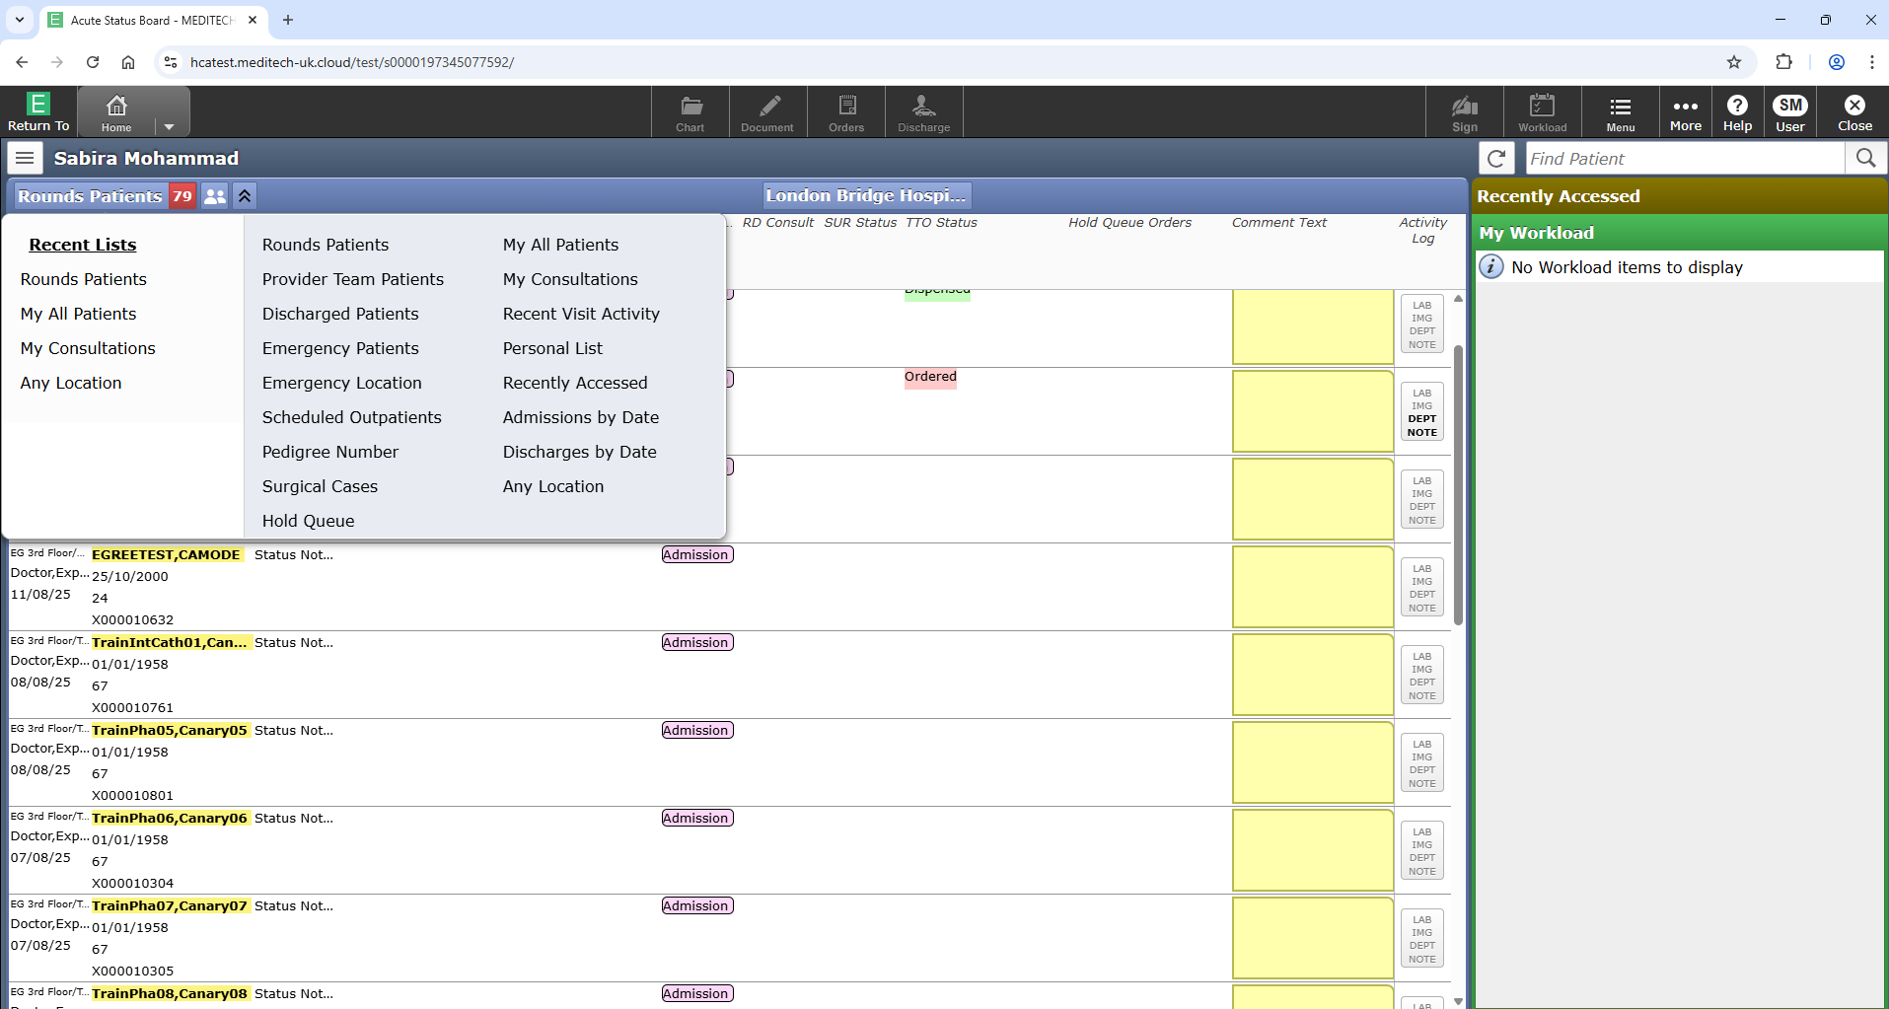
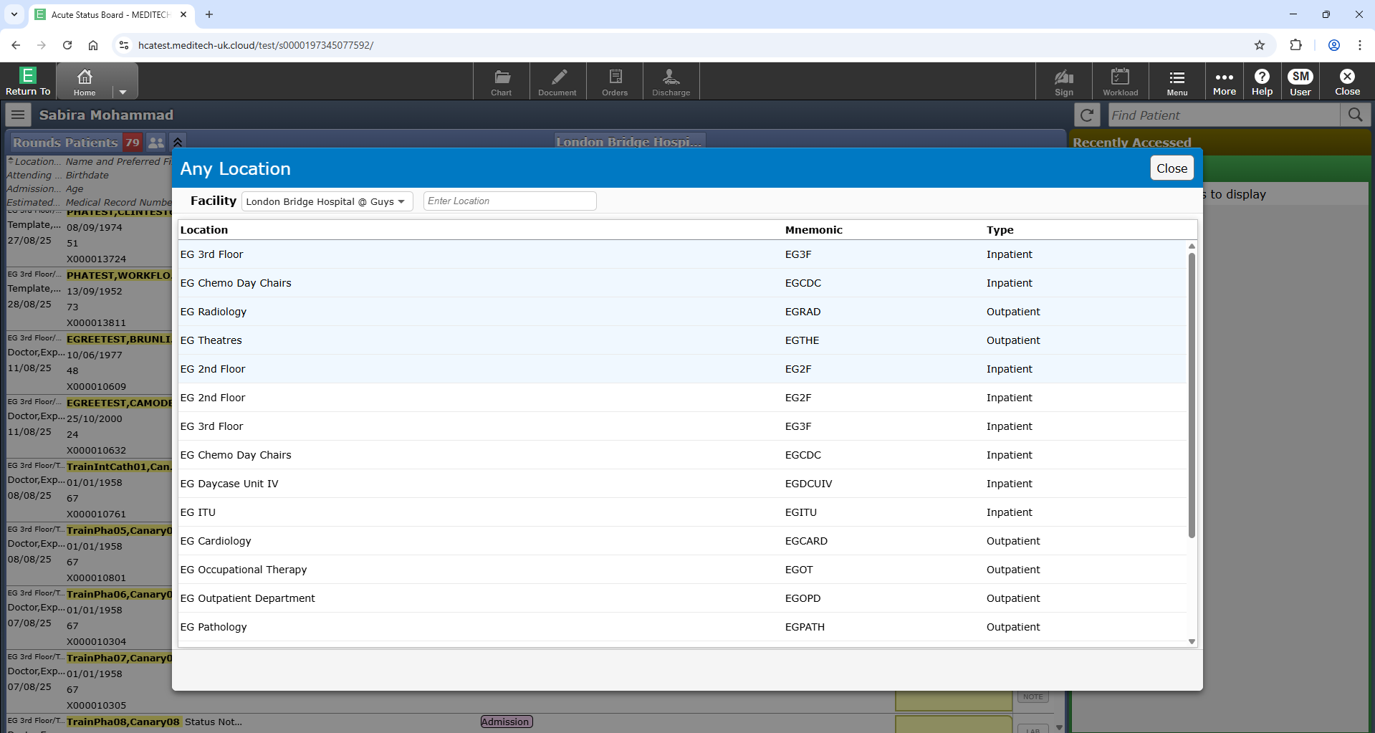
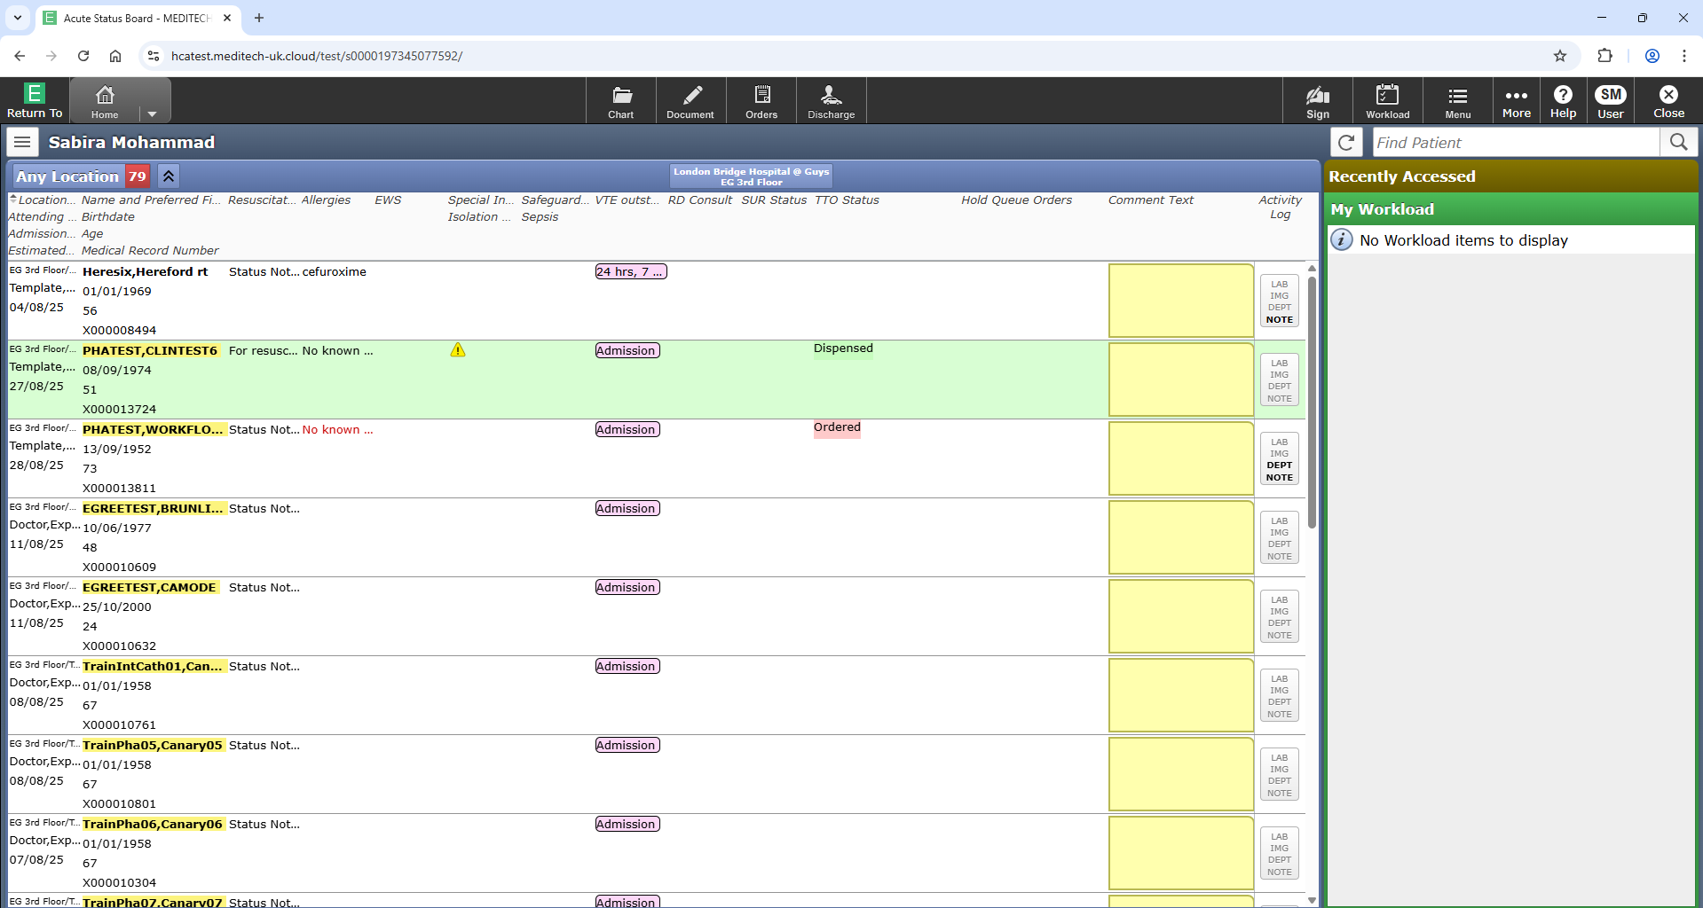
Home
Finding your patient from ward list
Click to return to menu page
On your home page, select “Acute Status Board”, the first option on the list
Click on “Round patients”, top right hand corner of the screen
Select “Any location”
Choose facility e.g., “London Bridge Hospital @ Guys”
Select ward e.g., “EG 3rd Floor”
A list of patients on the ward will appear
Double click on the name of your patient

Slide 6
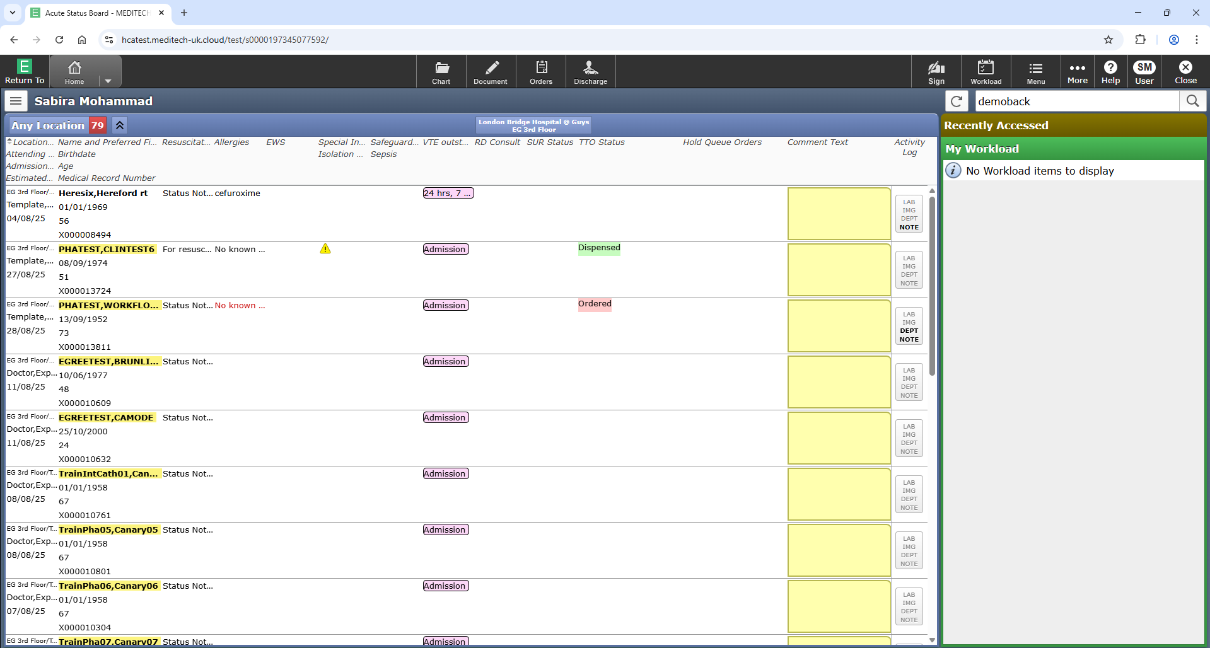
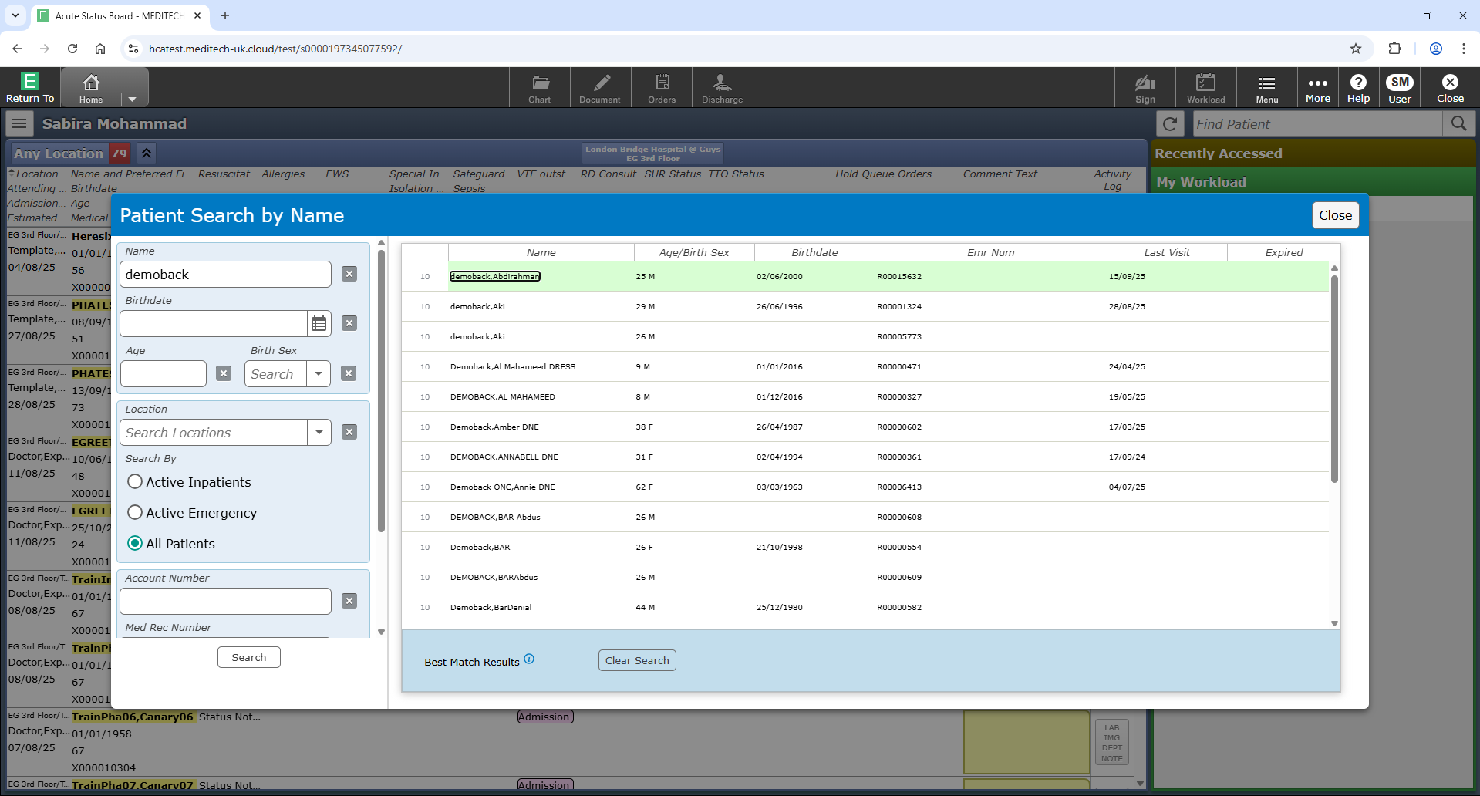
Home
Finding your patient from their details
Click to return to menu page
On your home page, select “Acute Status Board”, the first option on the list
Insert the patients name, date of birth or MRN in the “Find patients” bar on the top right hand corner
Fill in any additional details for the patient
Double click on the name of the patient you are looking for

Slide 7
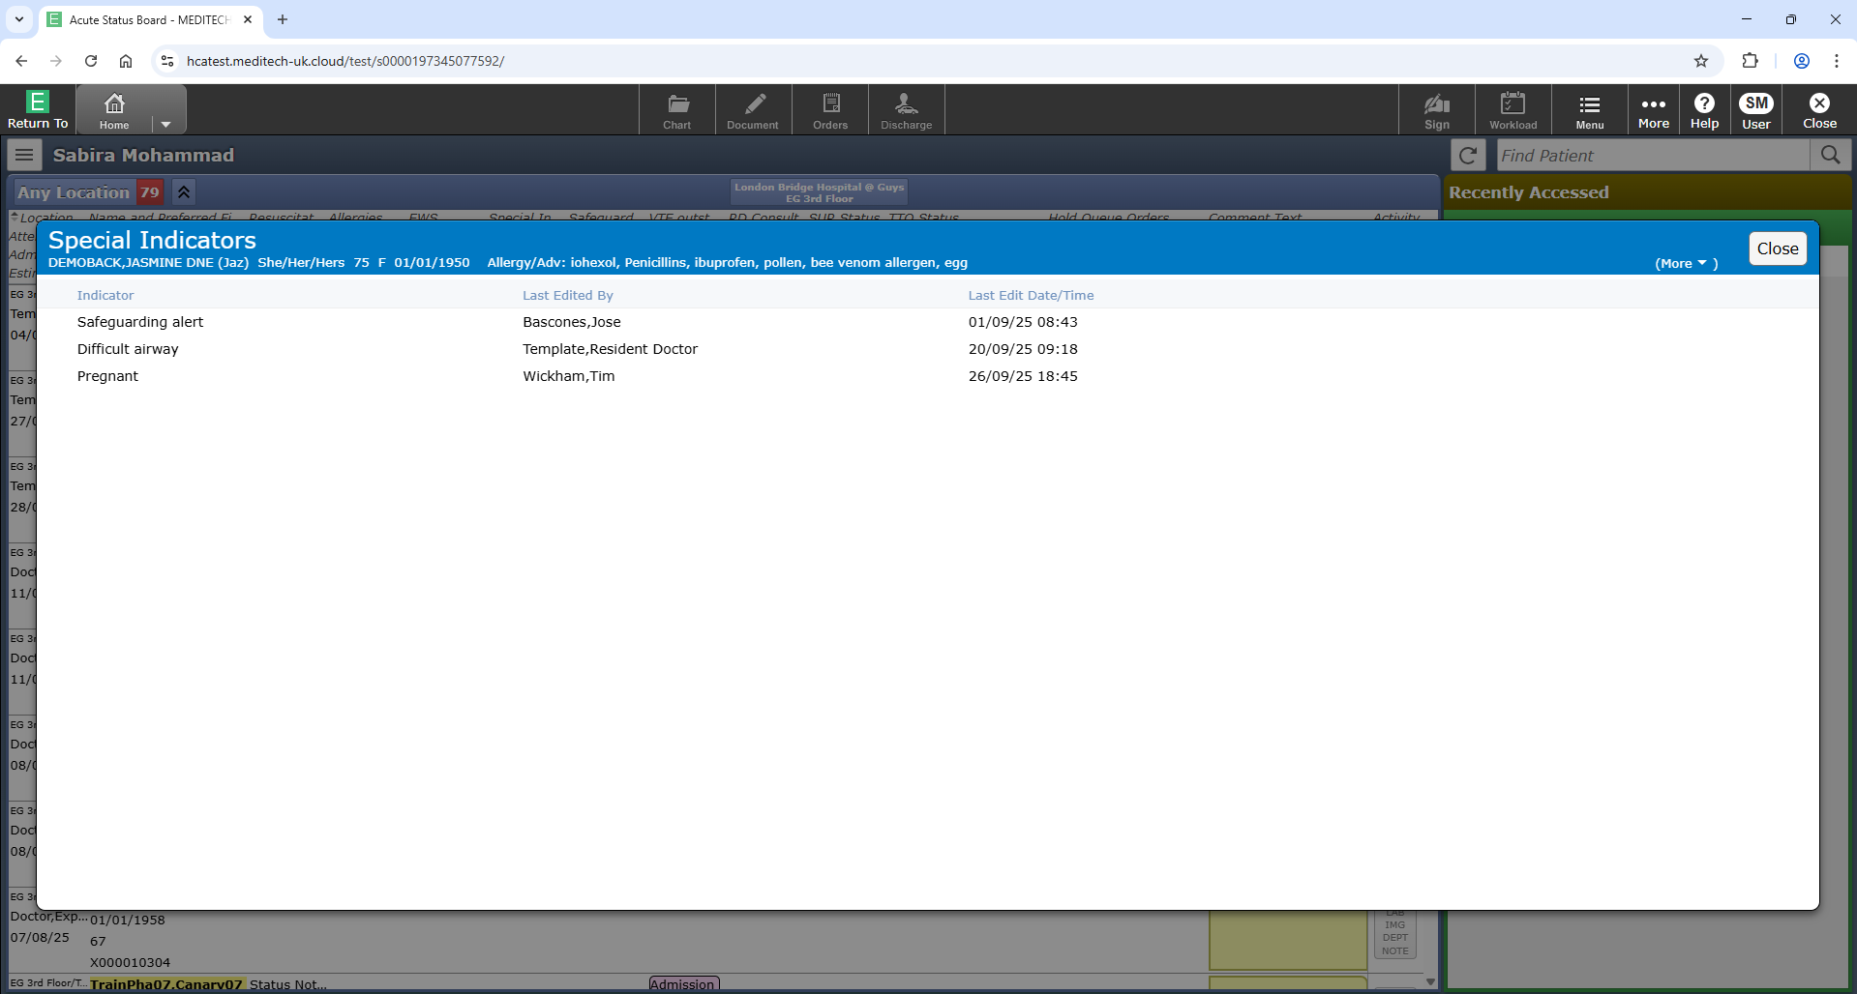
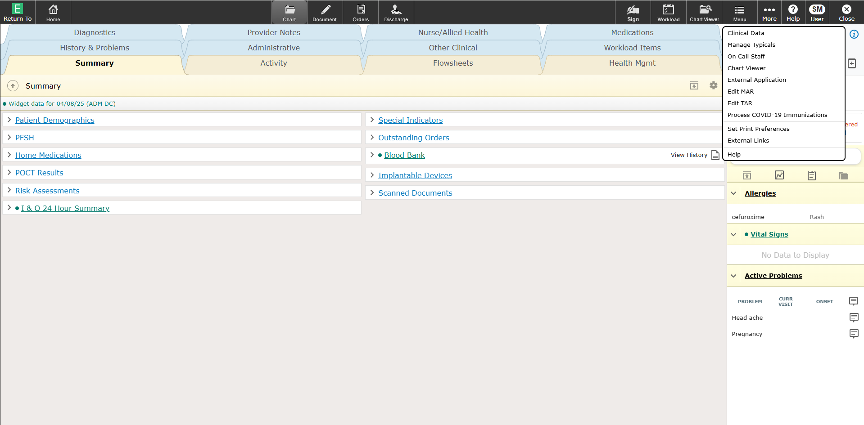
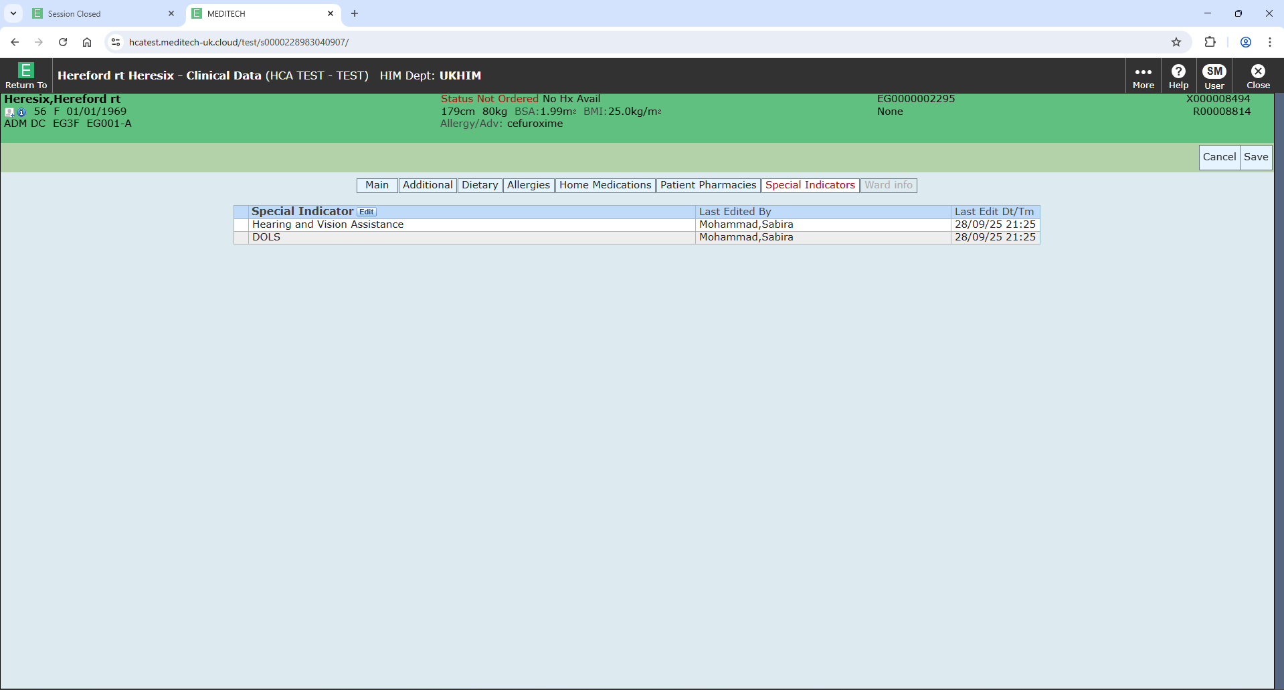
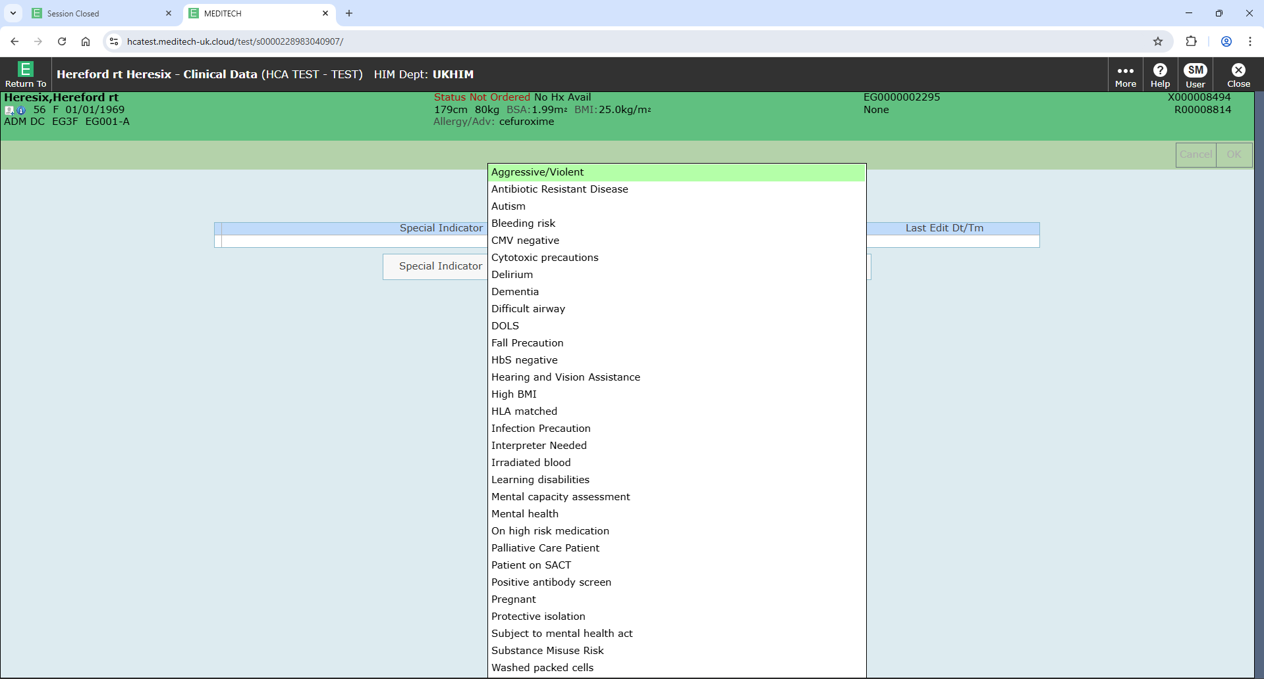
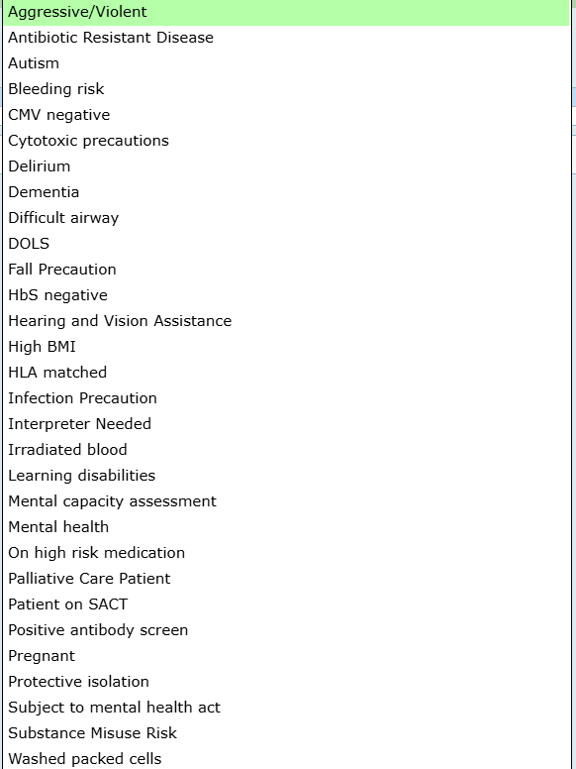
Home
Special indicators
Click to return to menu page
Reviewing existing “Special indicators”
When you select a patient, a “Special indicator pop up will appear is the patient has one
Adding new “Special indicators”
On the patient’s chart click on “Menu” top right hand corner
Select “Clinical Data” from the list (first option)
Select “Special Indicators”
Select “Edit”
Choose the appropriate “Special Indicator” from drop down
Choose “Ok” and then “Save”
Special indicators can also be edited and deleted from here
List of “Special Indicators” to choose from
No free text option

Slide 8
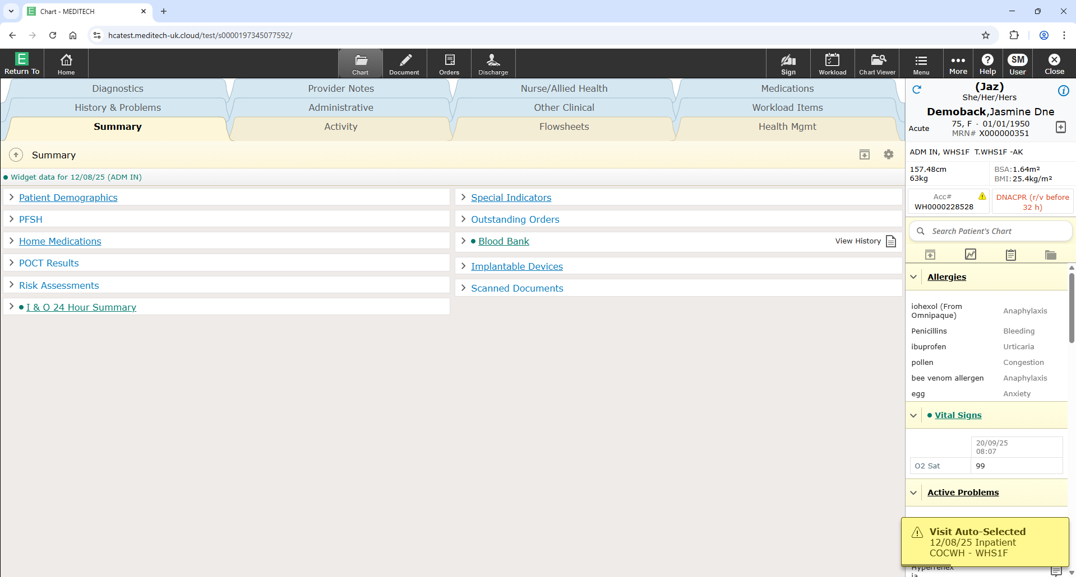
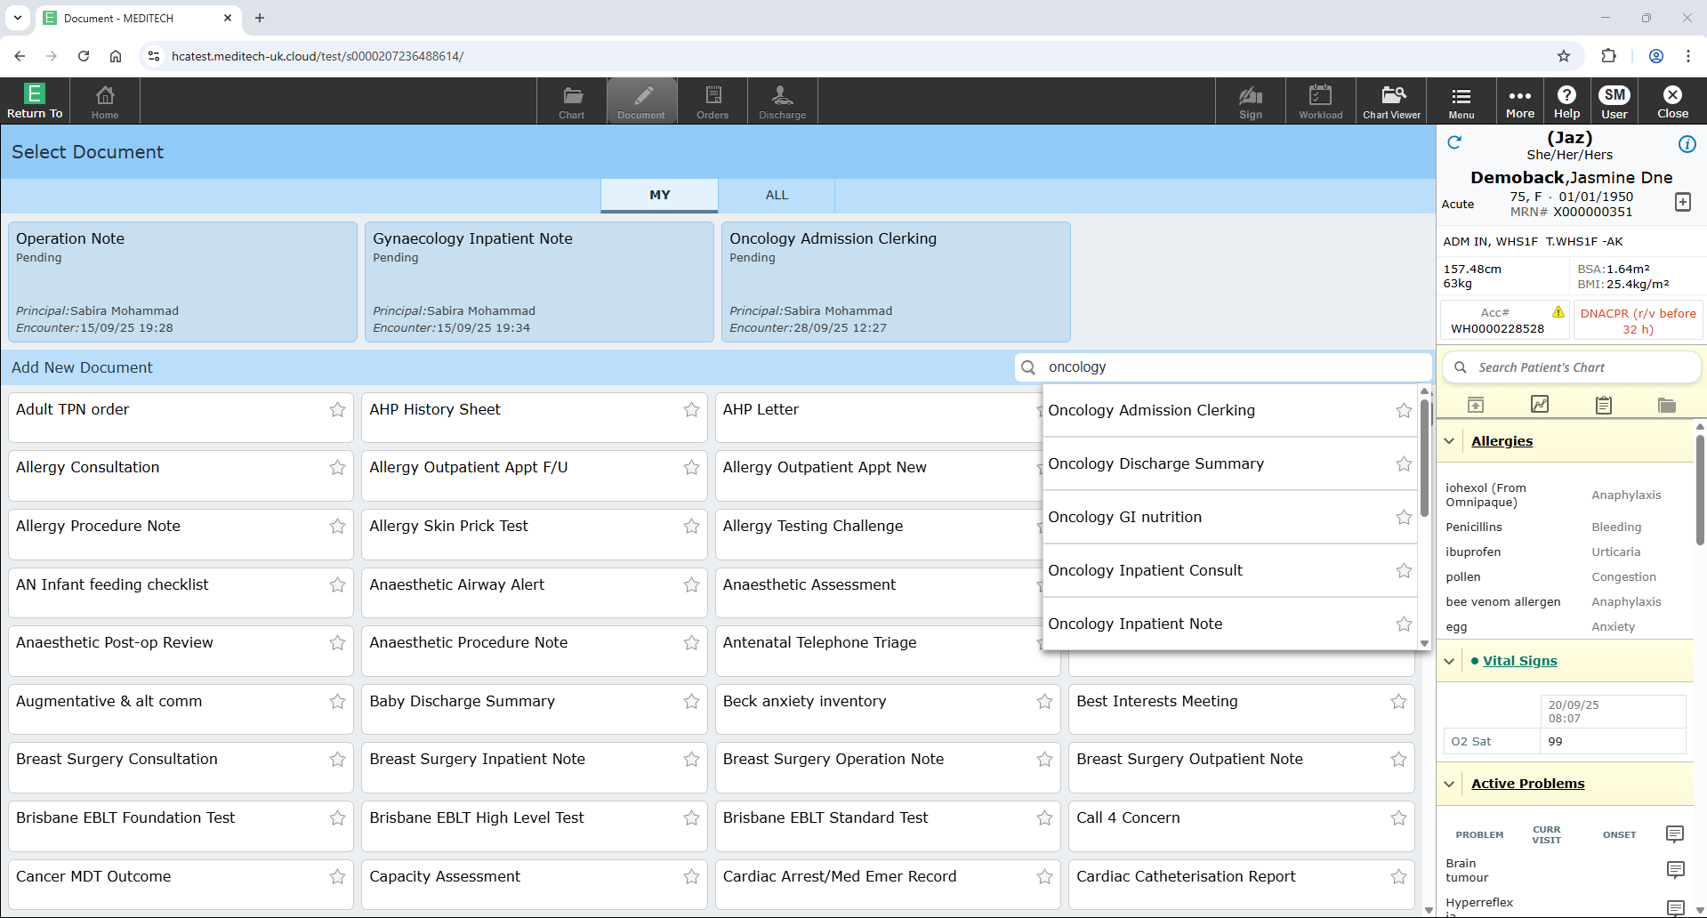
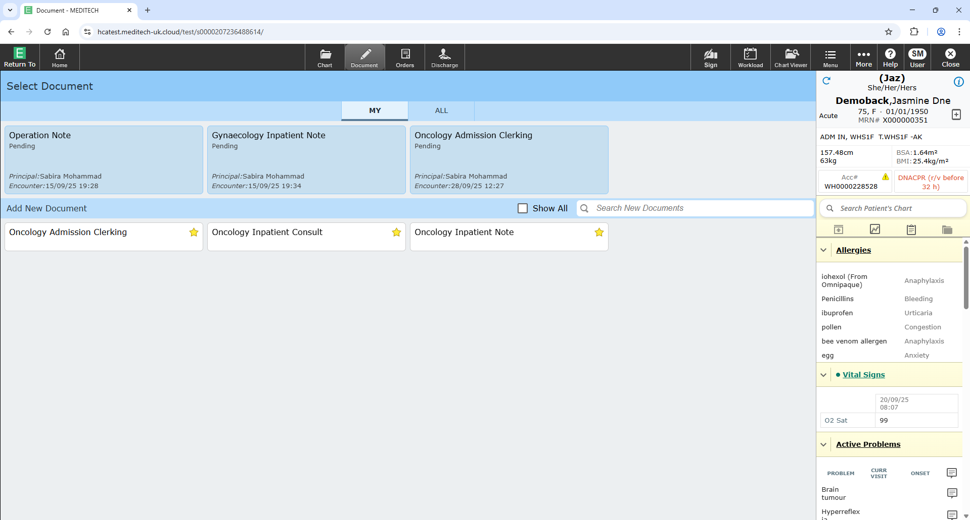
Home
Selecting the right document
Click to return to menu page
Select “Document” tab on patient’s home page
In the “Search New Documents” box, type “Oncology” or “Haem”
Favourite documents you will use frequently by clicking the star on the right of the document name
Documents you favourite will appear here whenever you click on a patient’s “document” tab

Slide 9
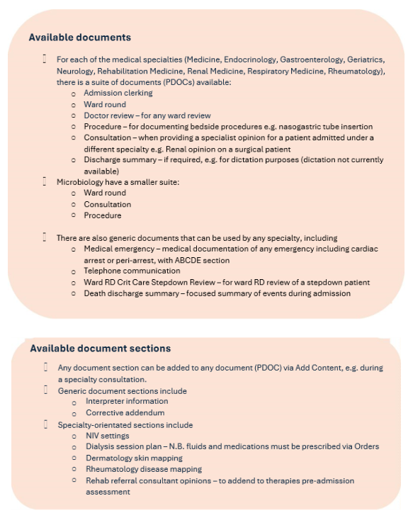
Home
Documents for medical specialties
Click to return to menu page

Slide 10
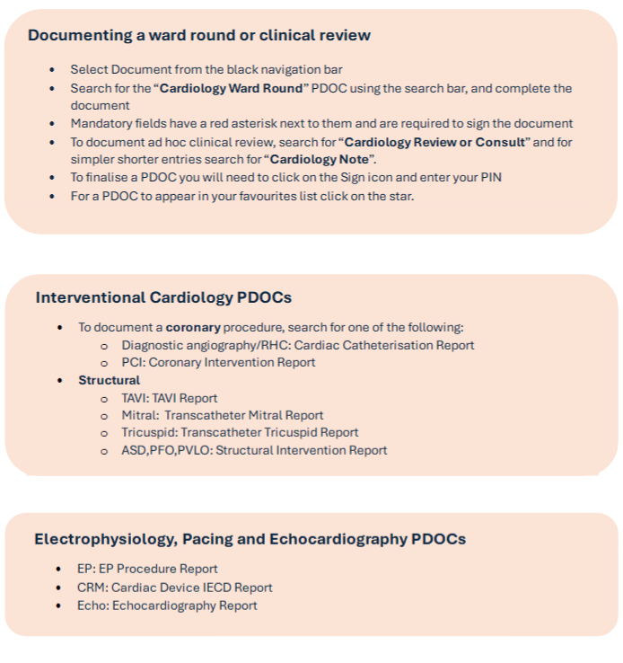
Home
Cardiology documenting
Click to return to menu page

Slide 11
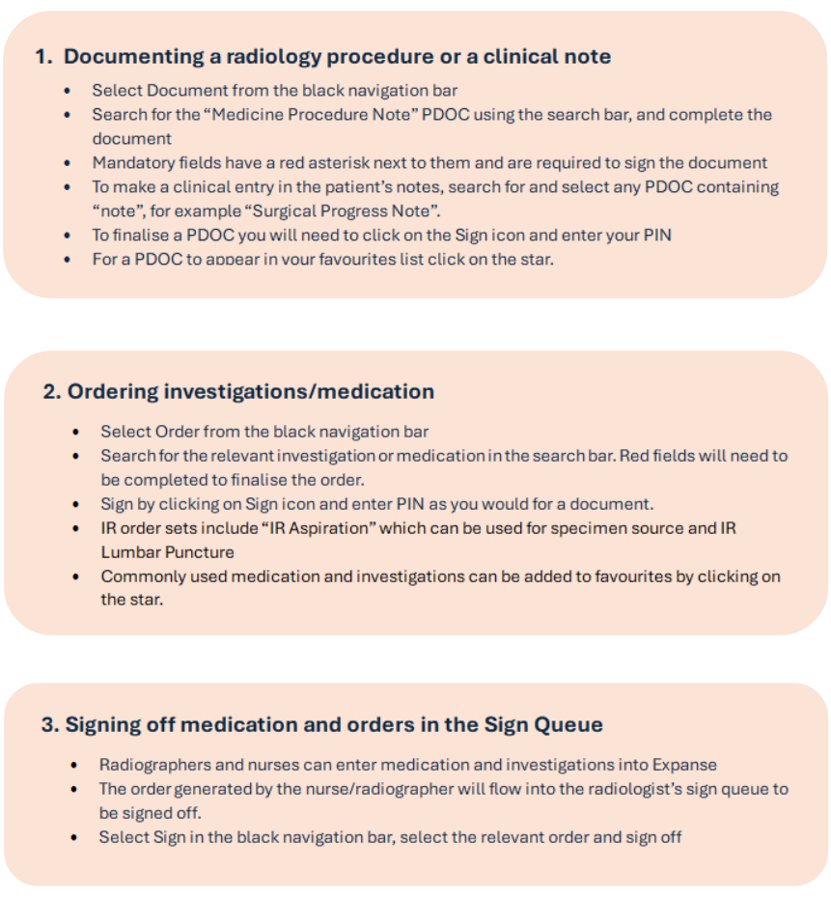
Home
Radiology documenting and workflow
Click to return to menu page

Slide 12
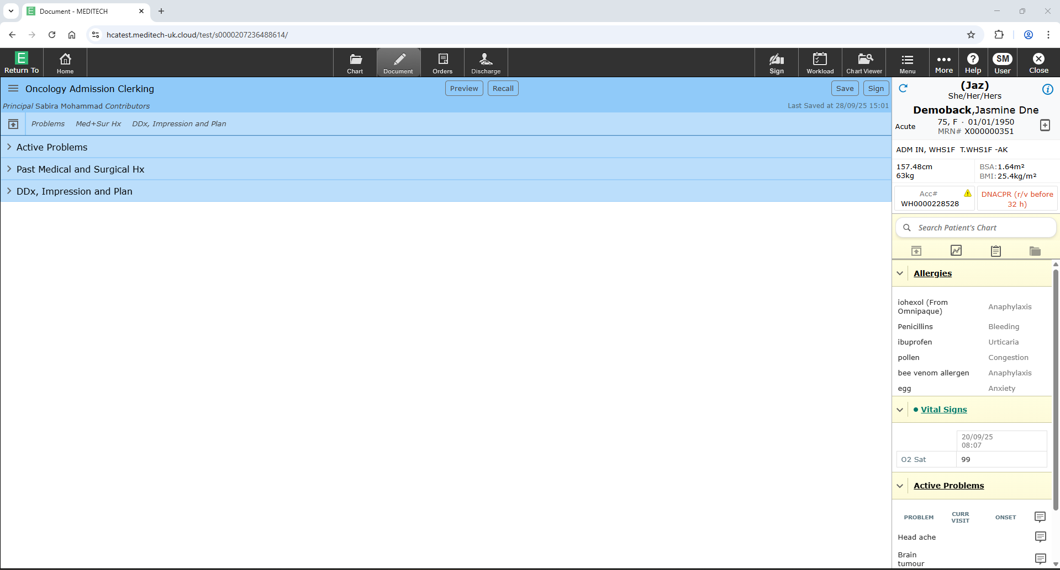
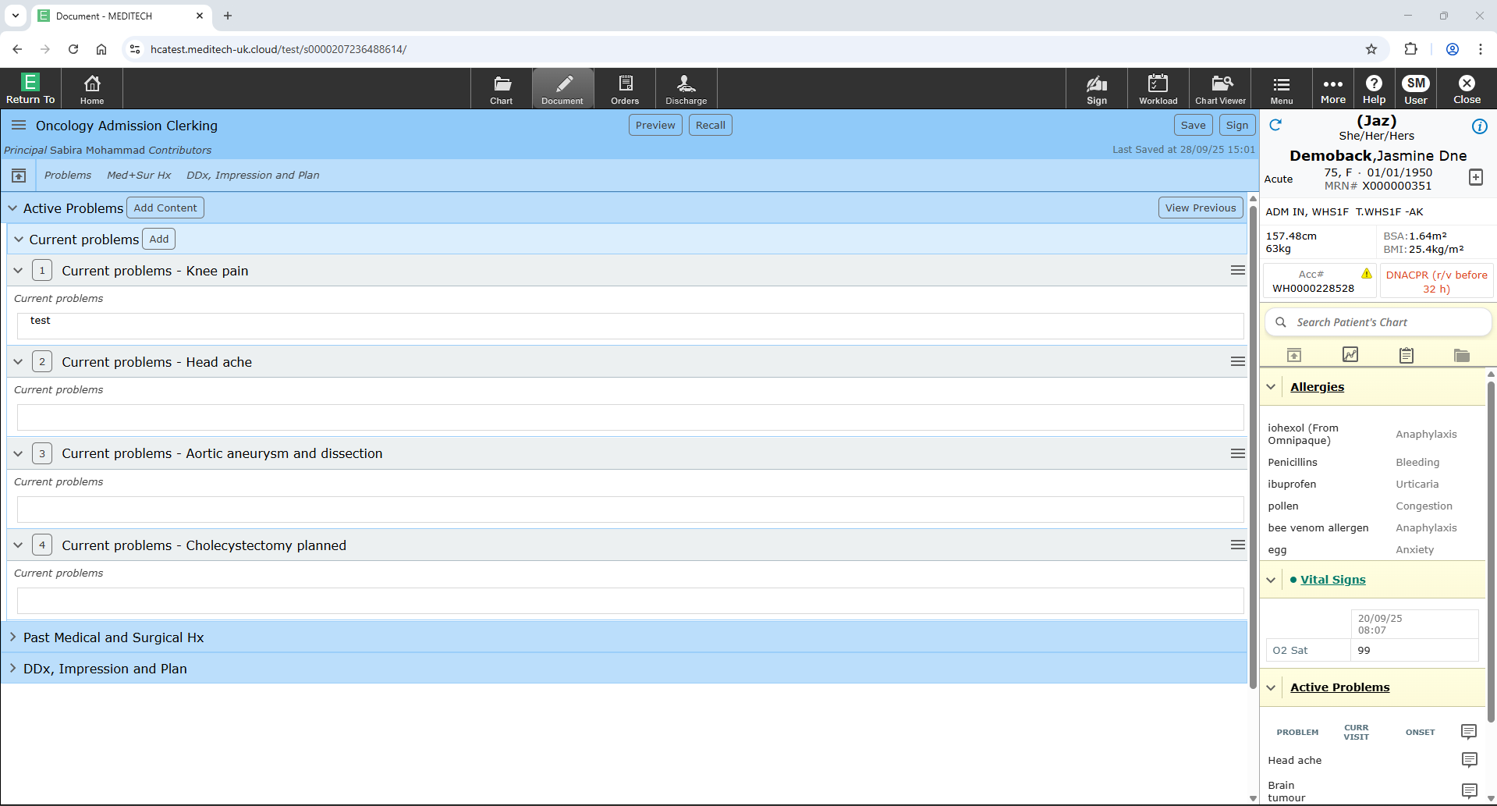
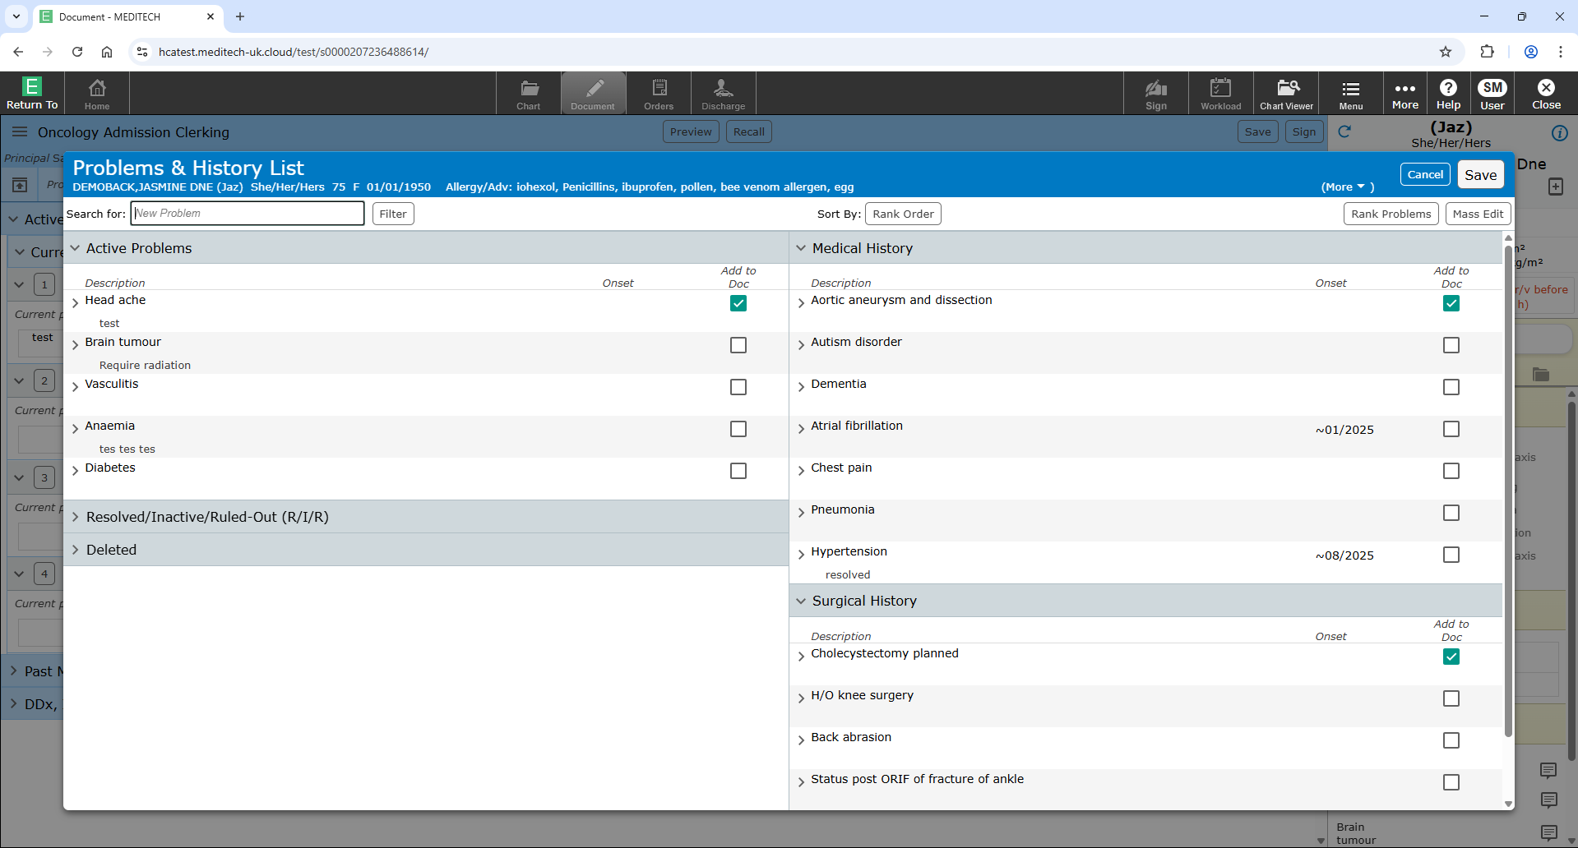
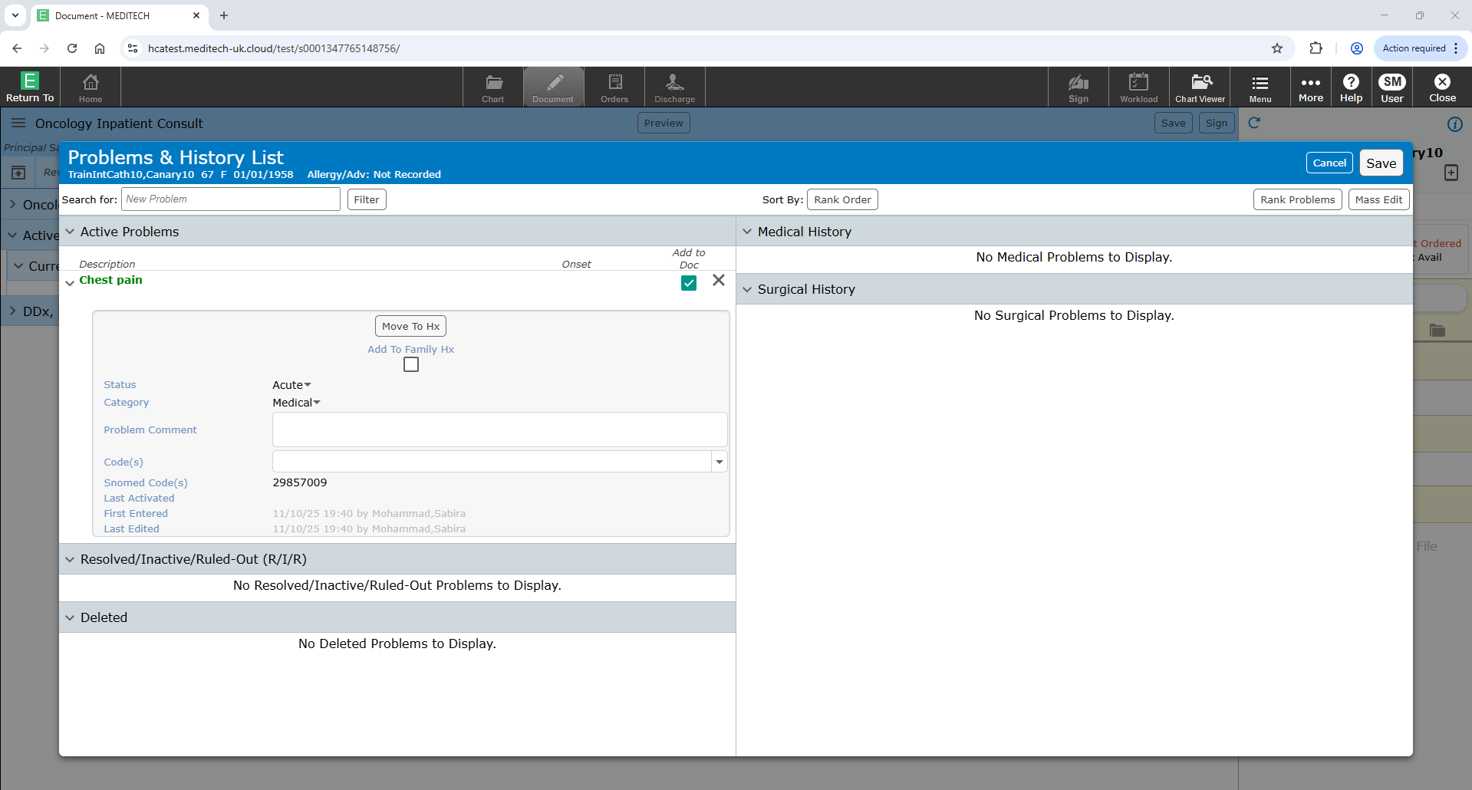
Home
Adding your entry: adding an active problem
Click to return to menu page
Each document will have sections to organise your documentation
Clicking on the arrow by a section, opens up the section so you can document
Add an “Active Problem” (i.e., “Current Issues”) by selecting “Active Problem section”
Click on “Add” next to “Current Problems”
Type in the “active problem” you want to add e.g., “chest pain”
Select if the problem is active, historic
Star if it is a problem you want at the top of your list in the future
Select the problem to add additional details including allocating it to a surgical or medical category

Slide 13
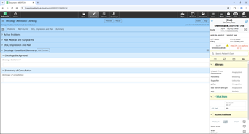
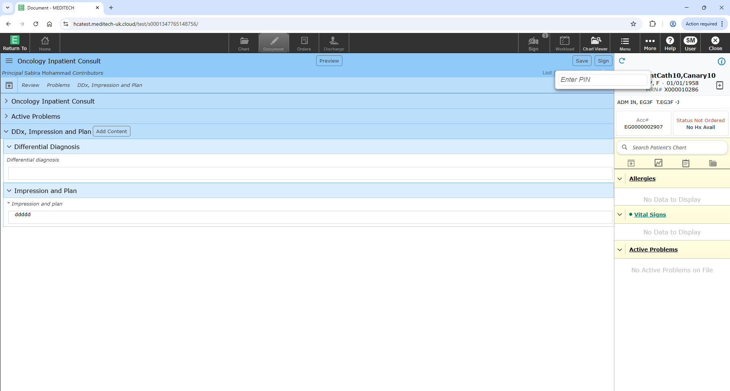
Home
Adding your entry: adding documentation to sections
Click to return to menu page
Work your way through each of the sections documenting your assessment
Any sections with an asterisk (*) must be completed before the document is saved
When you are finished, either save a draft of your document or sign it to complete it
Enter your pin to sign the document

Slide 14
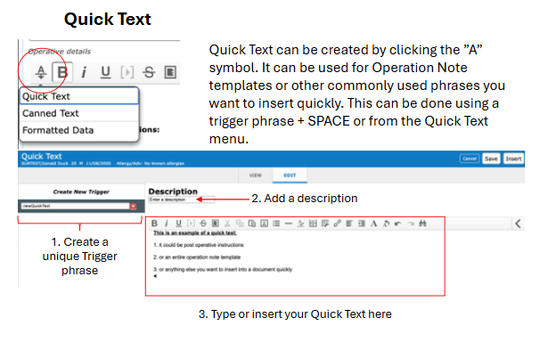
Home
Quick text
Click to return to menu page

Slide 15
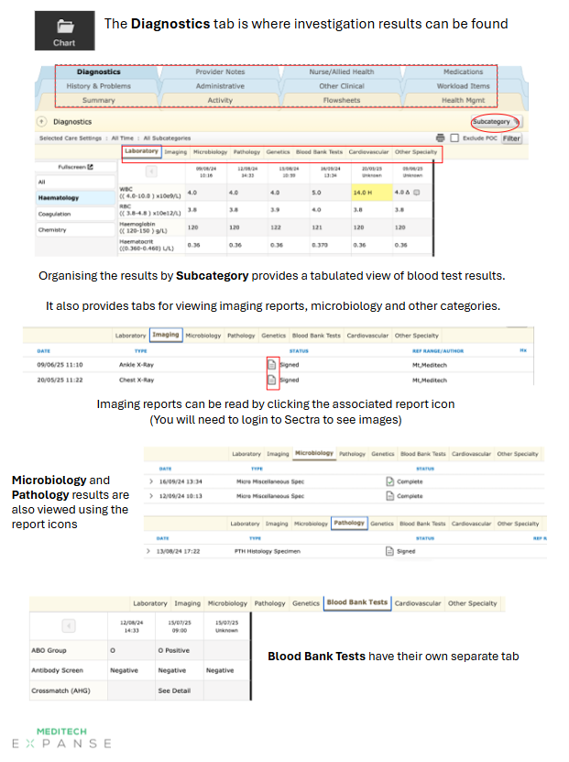
Home
Reviewing results
Click to return to menu page

Slide 16
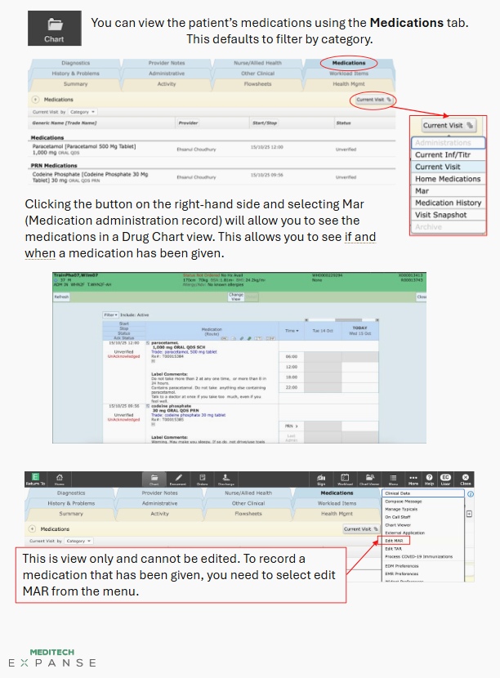
Home
Reviewing the drug chart
Click to return to menu page

Slide 17
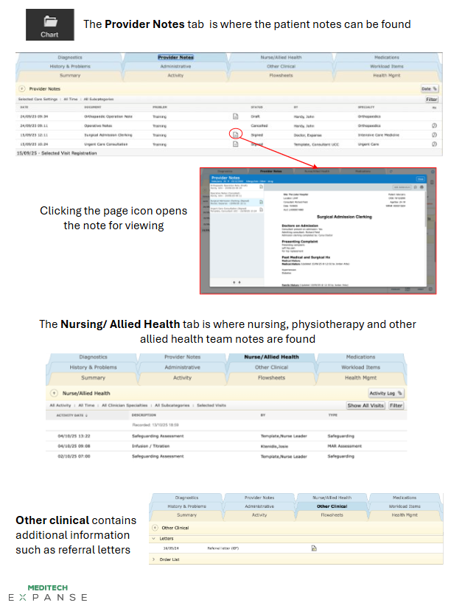
Home
Reviewing existing notes
Click to return to menu page

Slide 18
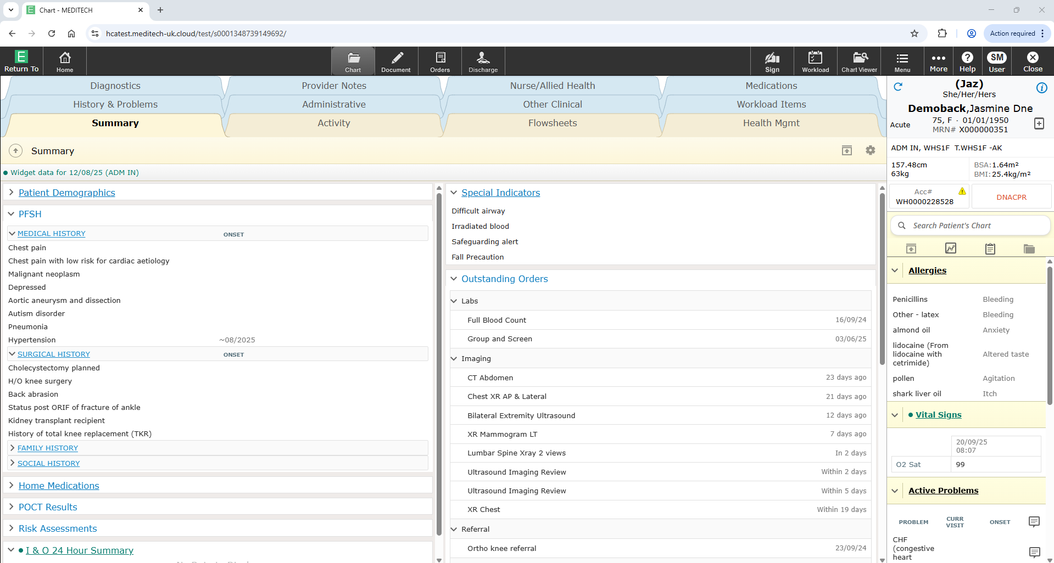
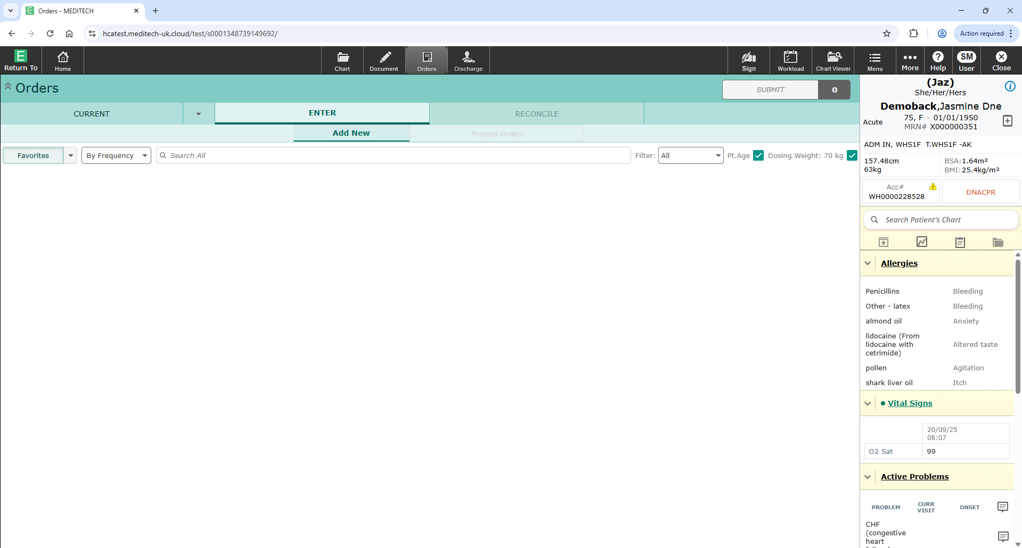
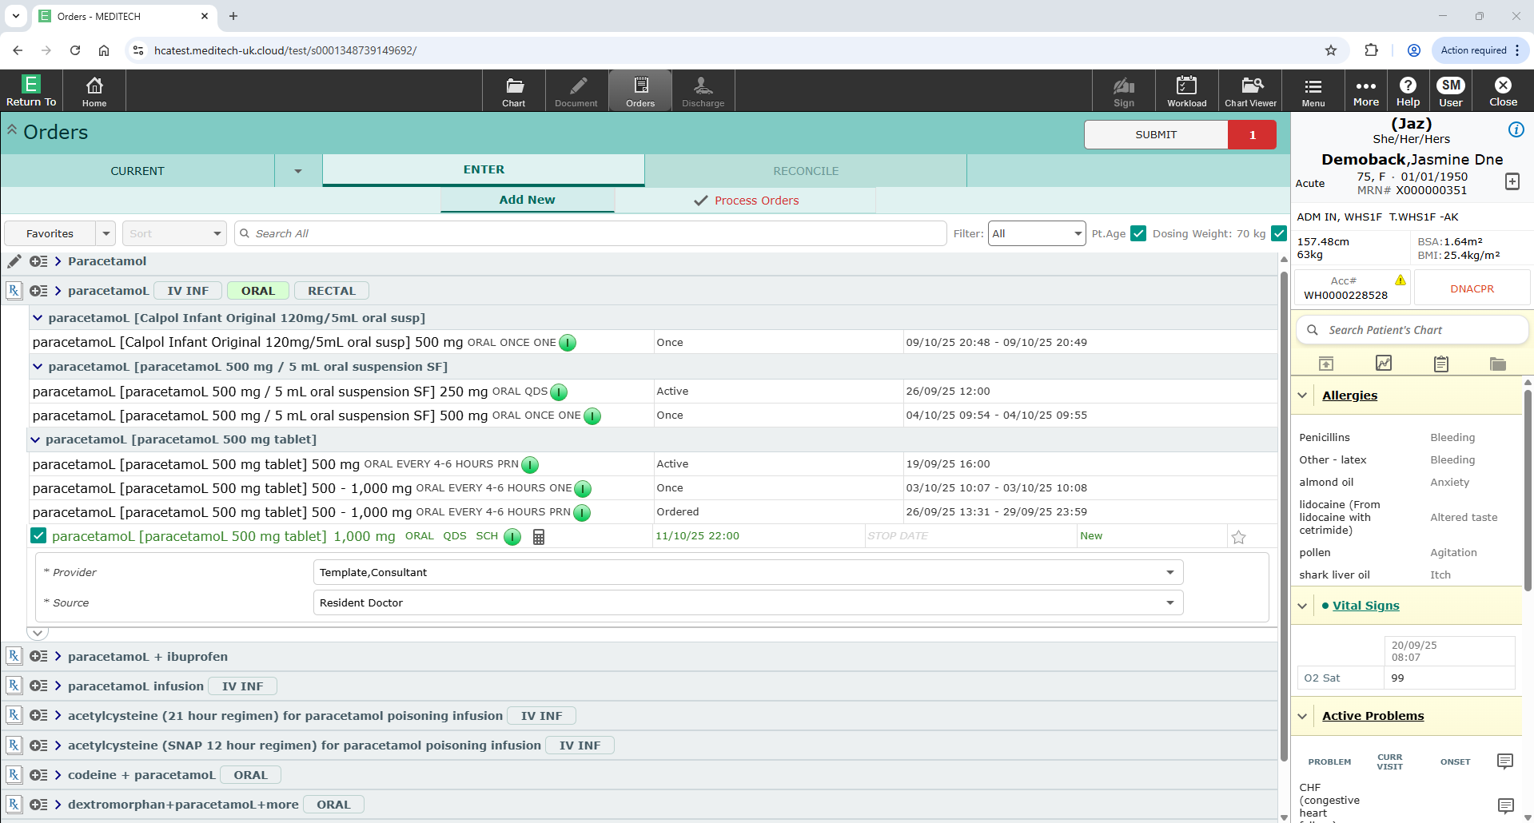
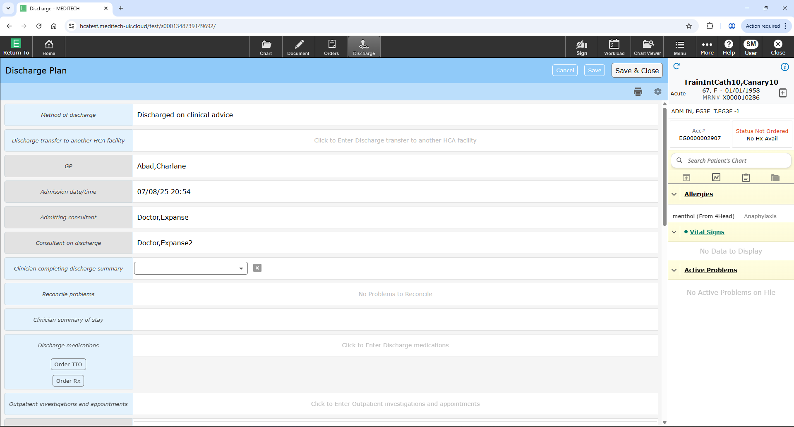
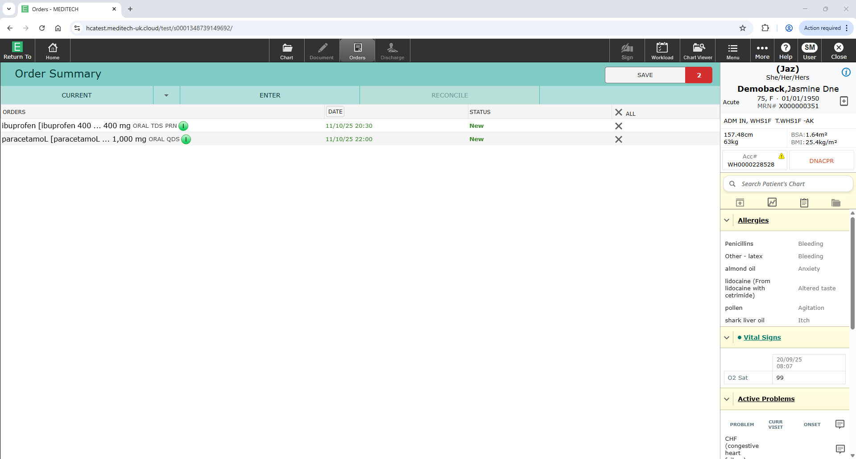
Home
Prescribing (ordering) drugs
Click to return to menu page
On the patient’s home page, click on the orders icon
Select “add new” under enter
Type in the name of the drug you wish to order
Complete any mandatory fields for each order
Order multiple drugs as required
Click submit and review the order on the submit page
Address any issues with the order
Save the order and enter your PIN when prompted

Slide 19
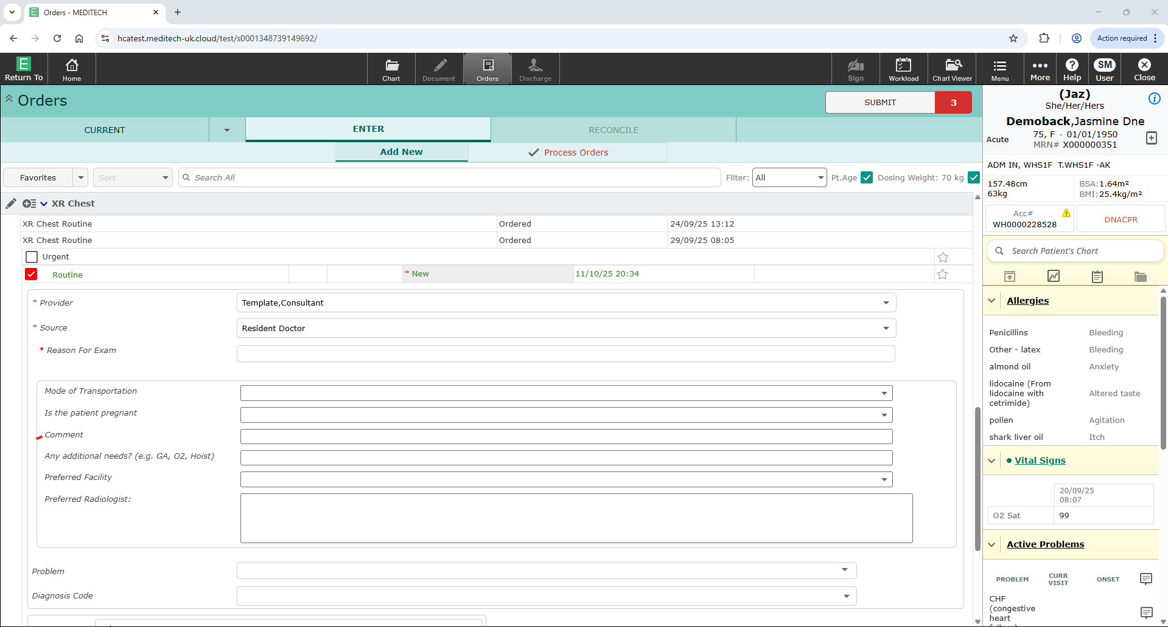
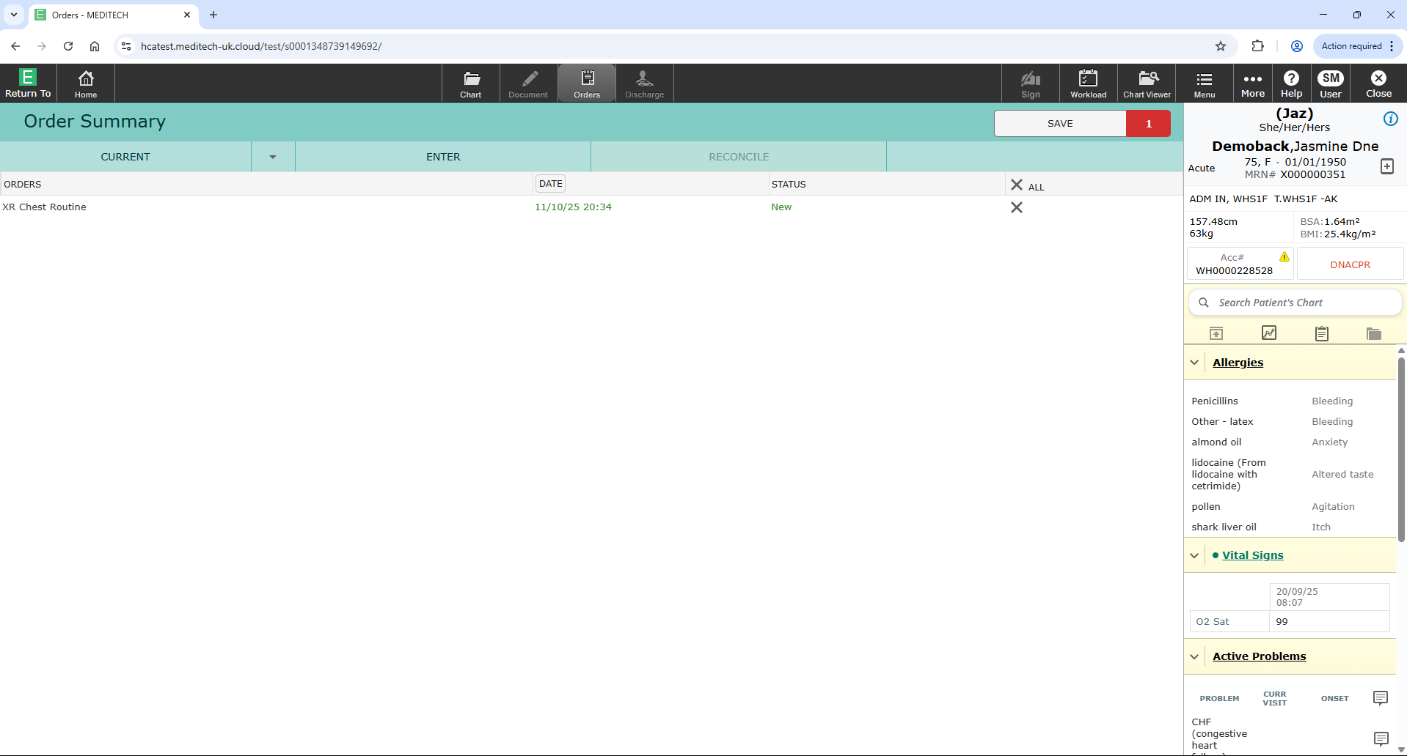
Home
Requesting (ordering) investigations
Click to return to menu page
Click for video
On the patient’s home page, click on the orders icon
Select “add new” under enter
Type in the name of the investigation you wish to order
Complete any mandatory fields for each order
Order multiple investigations as required
Click submit and review the order on the submit page
Address any issues with the order
Save the order and enter your PIN when prompted

Slide 20
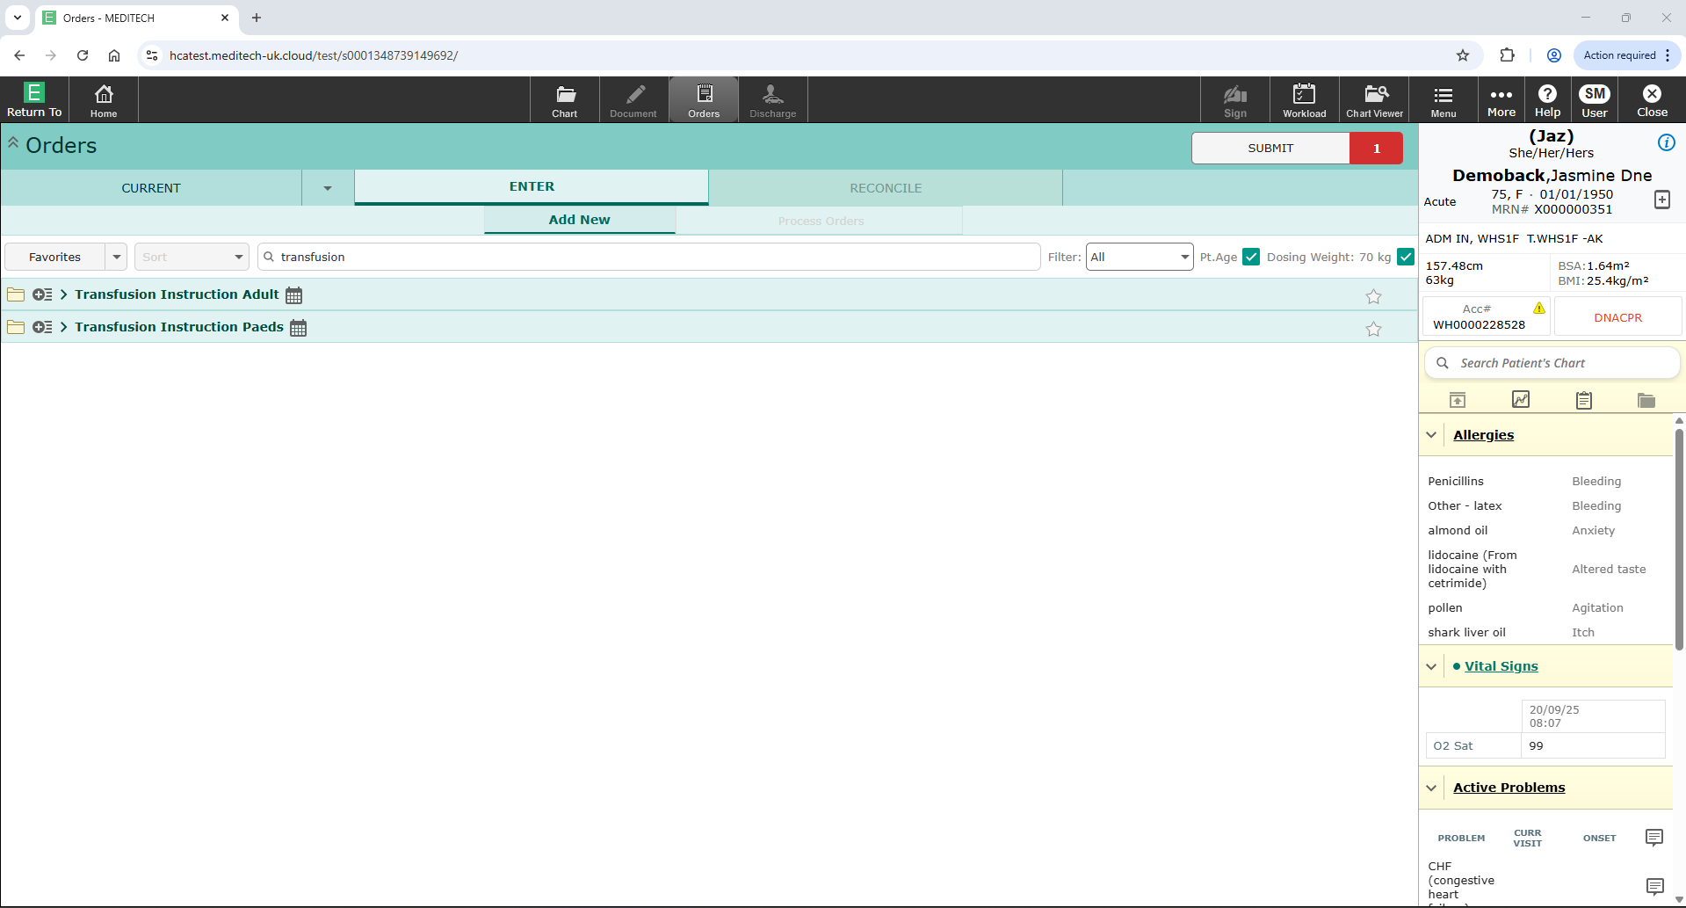
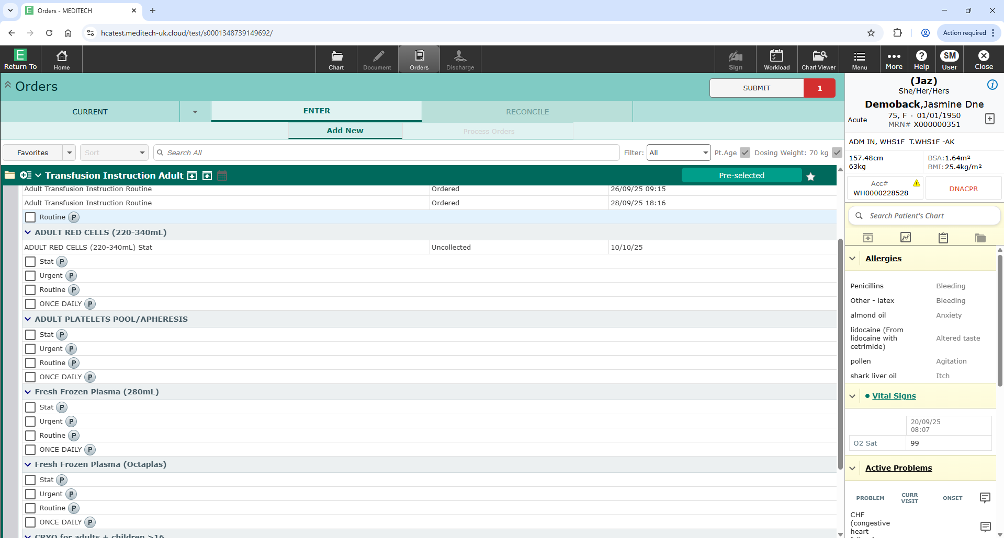
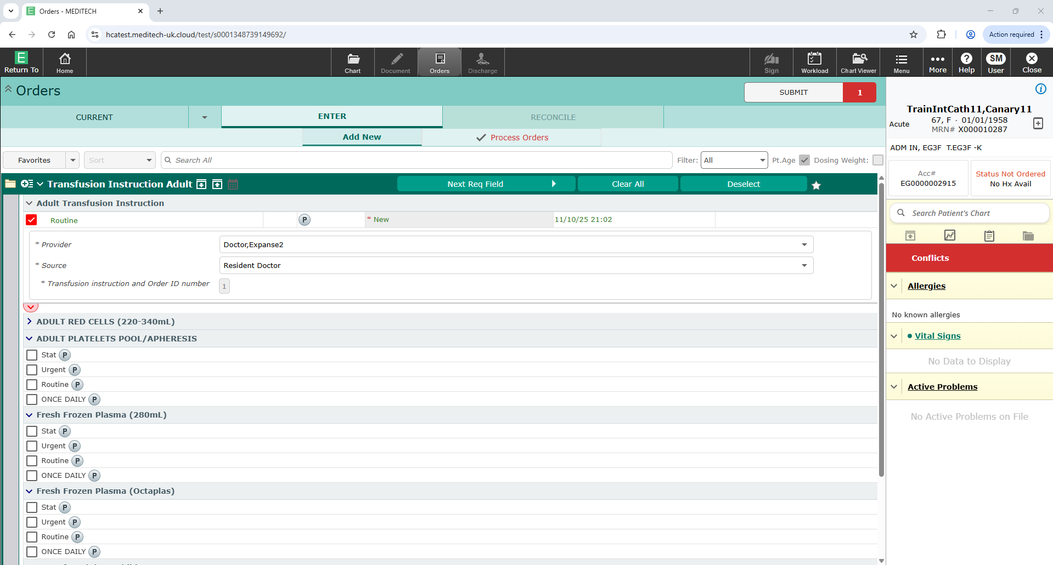
Home
Prescribing (ordering) transfusion
Click to return to menu page
On the patient’s home page, click on the orders icon
Select “add new” under enter
Type “Transfusion” in the search bar
Two options will appear
+ Transfusion Instruction Adult
+ Transfusion Instruction Paeds
Select one as appropriate
Review previous transfusion orders
Select “Adult Transfusion Instruction” by clicking on “Routine” box
This is he first option
Click on the red down arrow to complete the instruction (prescription)
Complete all relevant fields
Submit the order
Save the order and enter your PIN when prompted

Slide 21
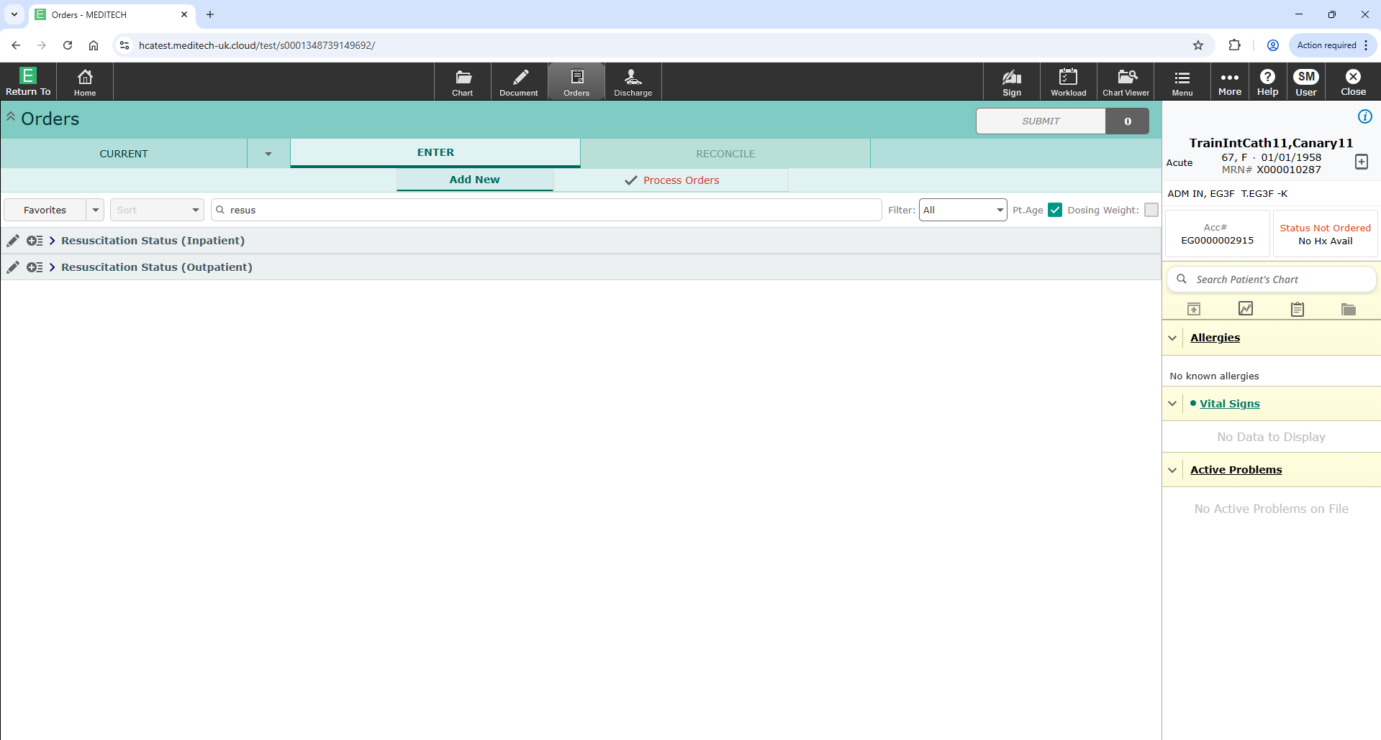
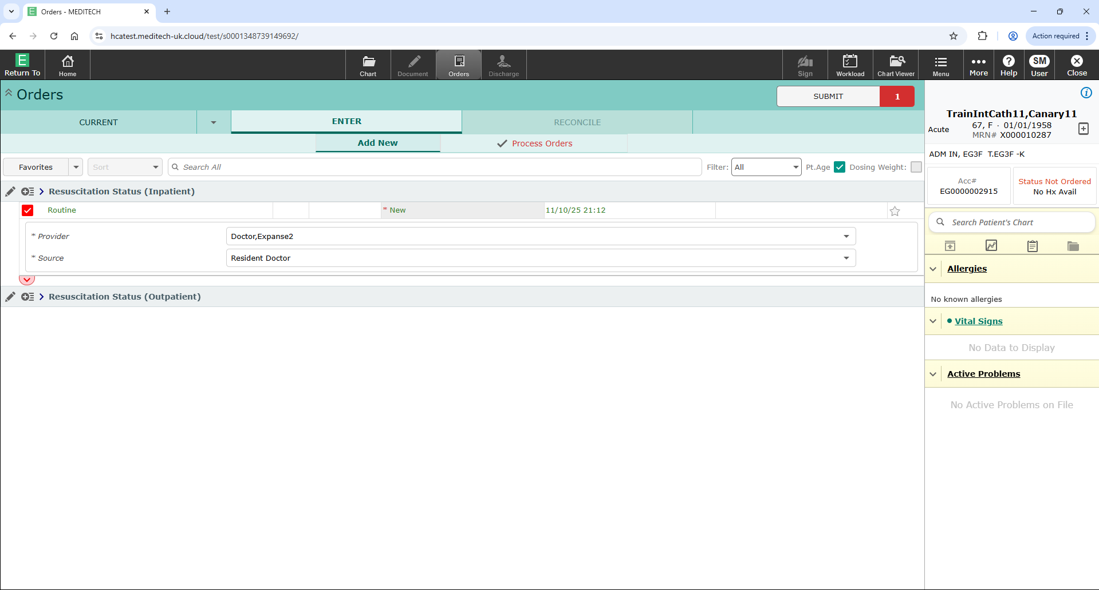
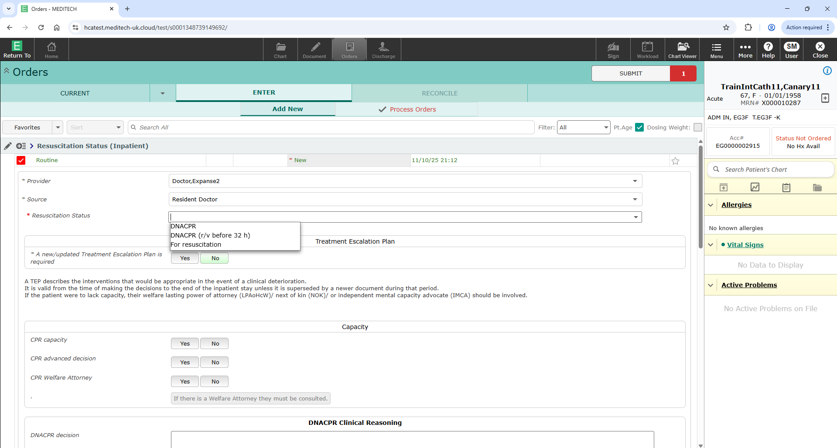
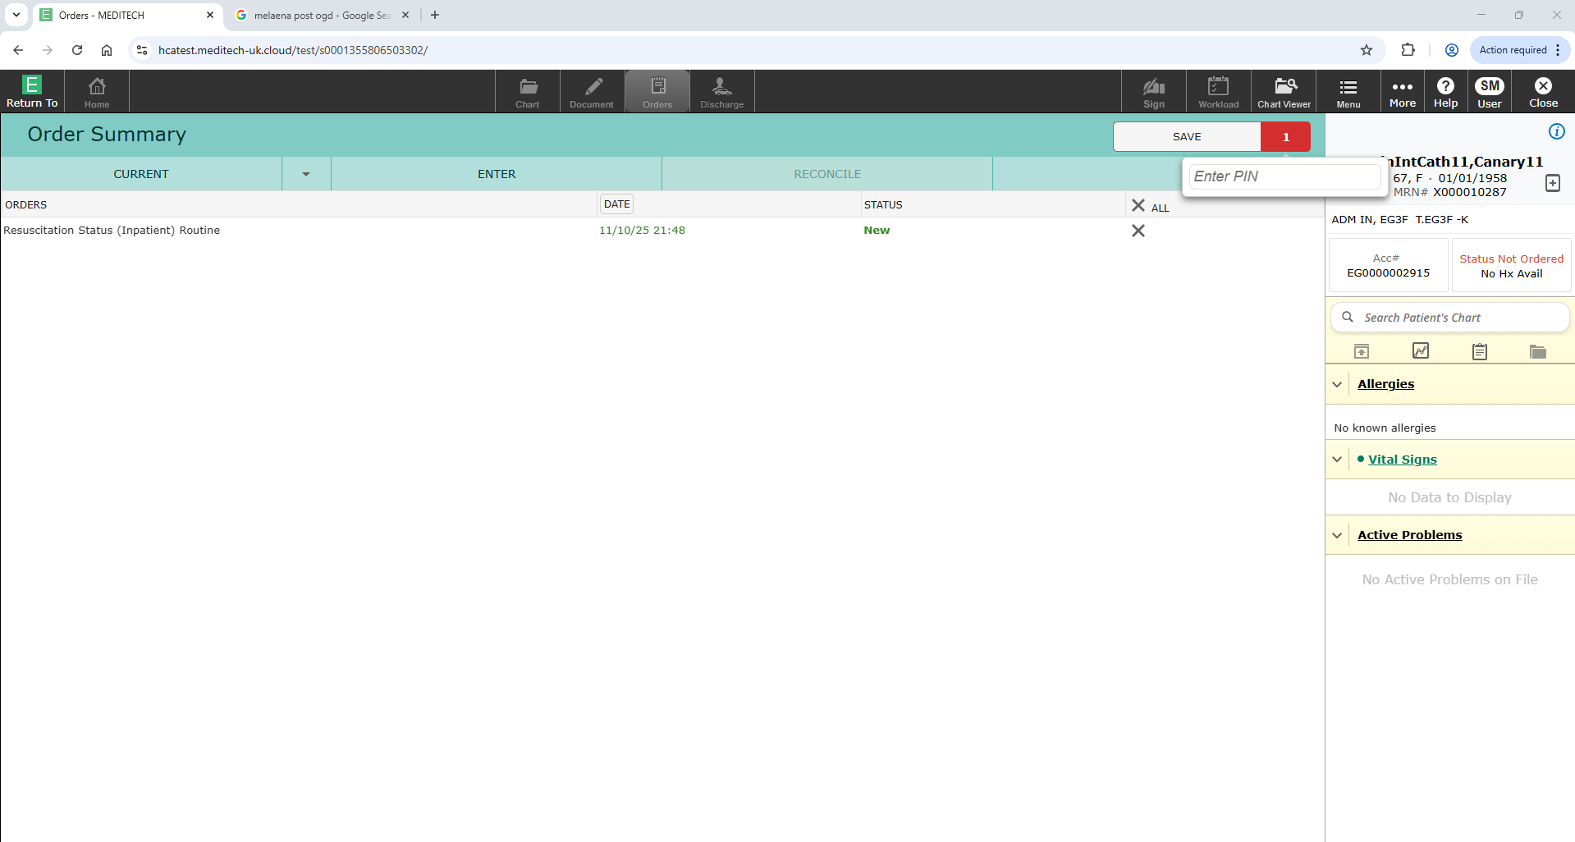
Home
Completing (ordering) resus
Click to return to menu page
On the patient’s home page, click on the orders icon
Select “add new” under enter
Type “Resus” in the search bar
Two options will appear
+ Resus status (Inpatient)
+ Resus status (Outpatient)
Select one as appropriate
Click on the red down arrow to completed the instruction
Under resuscitation status
Consultants select DNACPR or For resuscitation
RMOs select DNACPR or For Resuscitation
Complete all required fields and submit
Save and enter your PIN when prompted

Slide 22
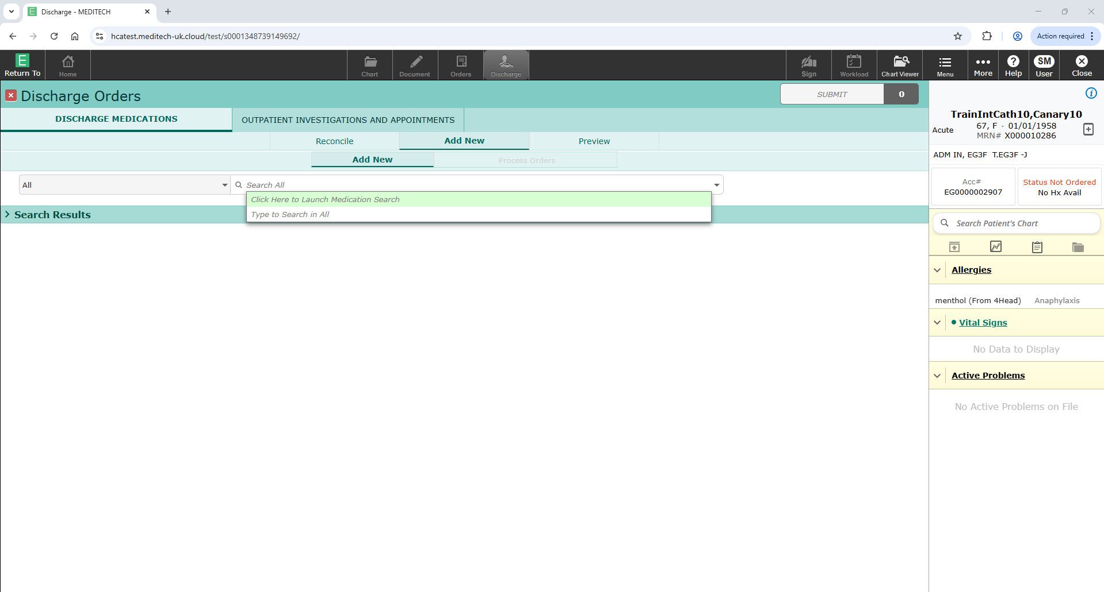
Home
Writing (ordering) TTOS and the discharge summary
Click to return to menu page
Select the discharge icon at the top of the patient record to open the discharge page
Complete the relevant sections, usually “clinician summary of stay”
To complete the TTOs, selct Order TTO
You will have the option to “Reconcile”, “Add new”, or “Preview” the TTO
Reconcile when the patient has drugs prescribed on their MAR
Add new when you want the patient to go home with drugs that are not on the MAR

Slide 23
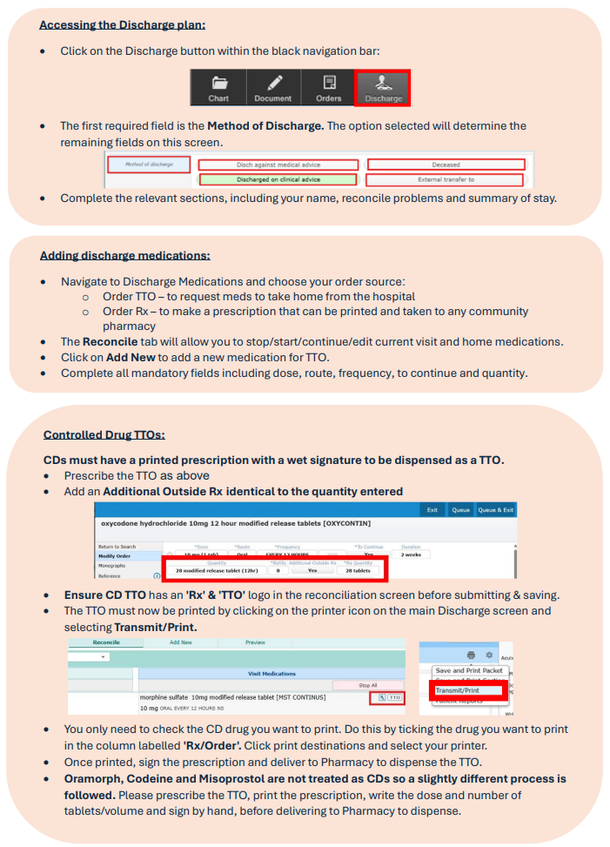
Home
Completing a TTO for a controlled drug
Click to return to menu page

