Slide 1

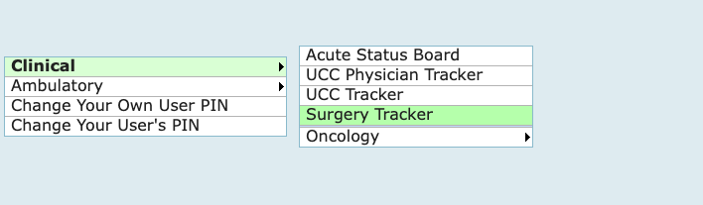
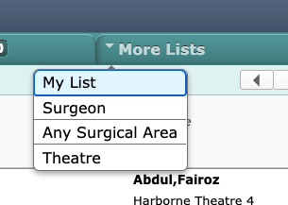
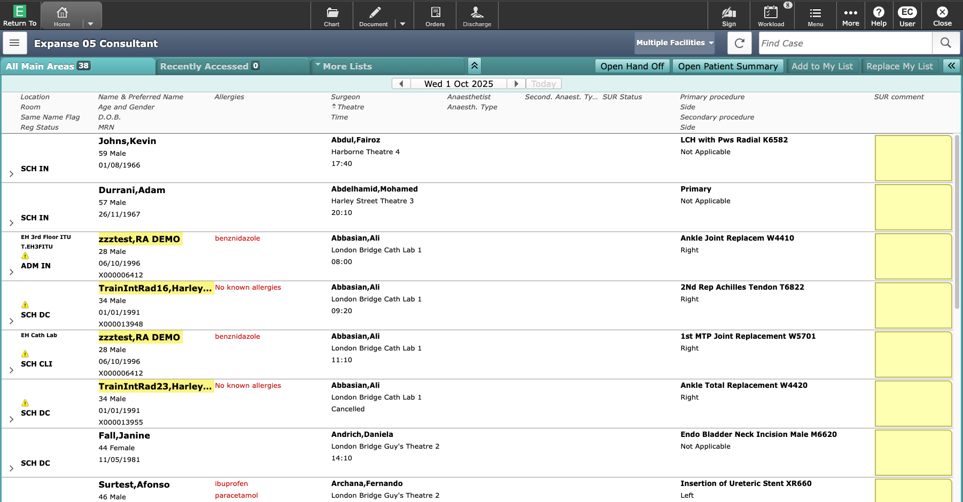
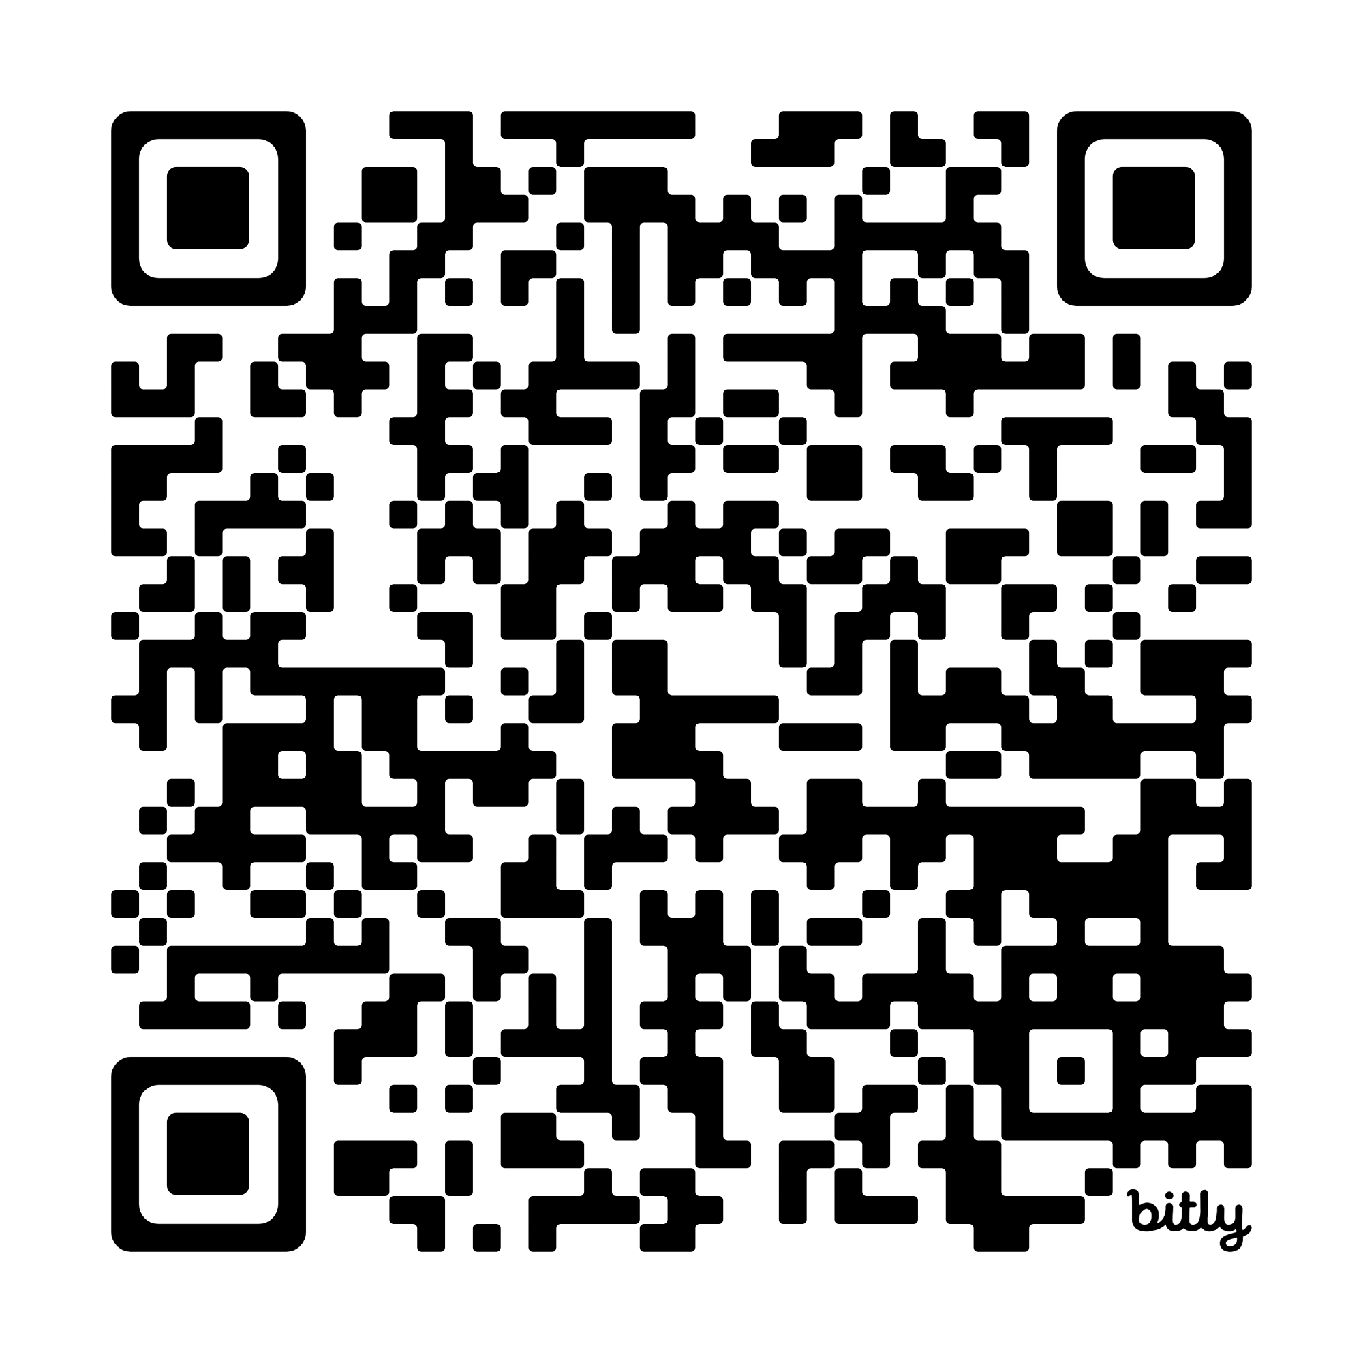

2
Operation Notes
Finding theatre patients
Theatre lists are accessed from the Surgery Tracker
All Main Areas tab shows patients in all locations
More Lists allows you to filter by person, surgical area or theatre.
You can also specify the facility from the Multiple Facilities tab
Patient information
Surgeon, location and time
Procedure information
Single click to select a patient
Go to 43:57

Slide 2
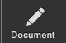
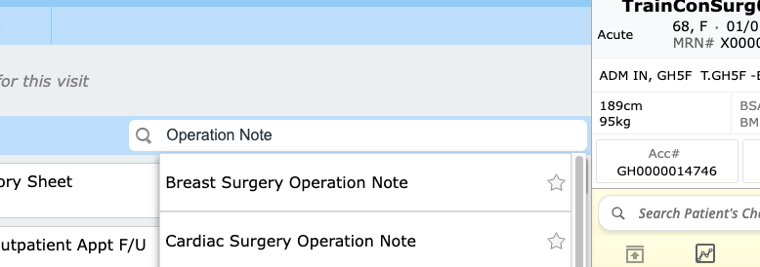
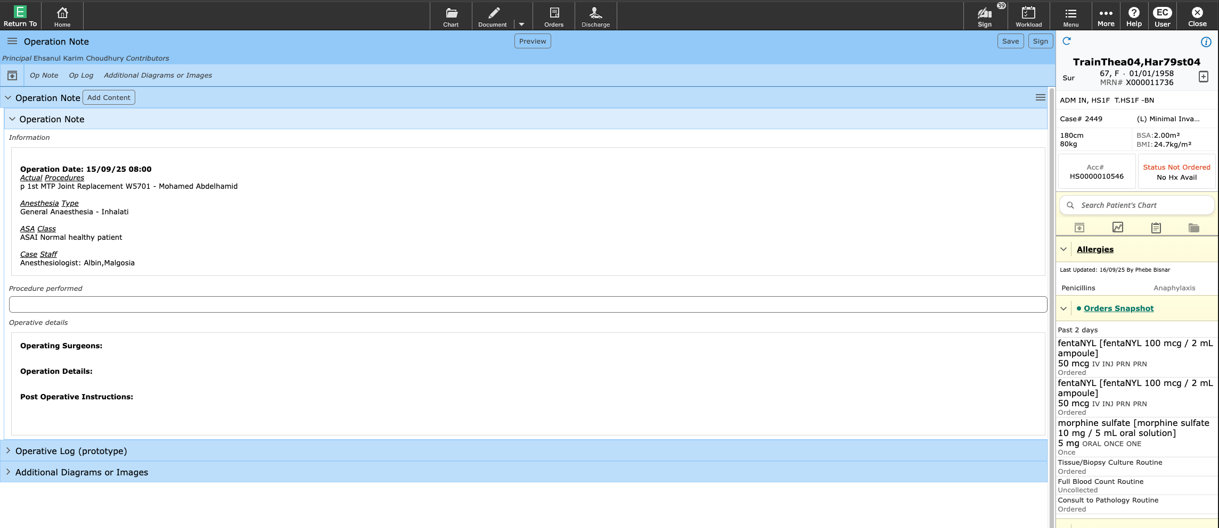
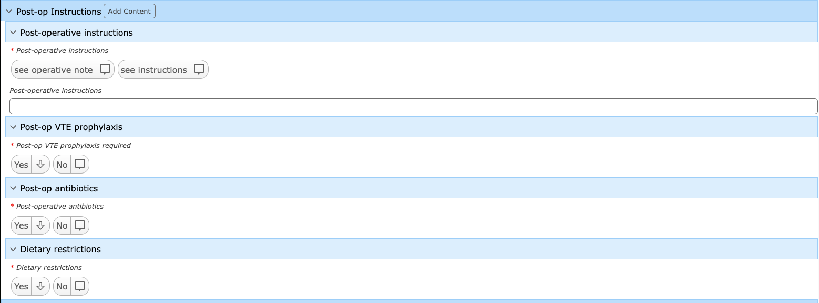
2
Operation Notes
With the patient highlighted, use the Document button to load the documentation screen
Use the search bar to find Operation Note.
This can be added to favourites by clicking the star.
Operation date, time, procedure name, CCSD code, operating surgeon, ASA and other information automatically pull through
Operation note can be typed, pasted or inserted as Quick Text here
Post operative instructions require the Antibiotic and VTE instructions to be documented
Tip: Mandatory fields are marked with a red asterisk (*)

Slide 3
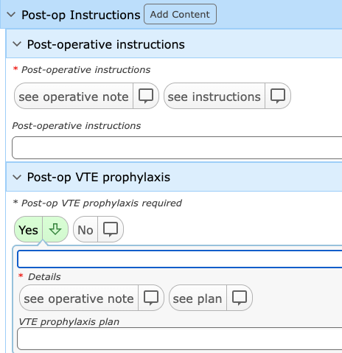
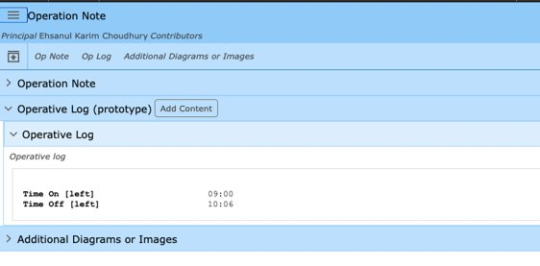
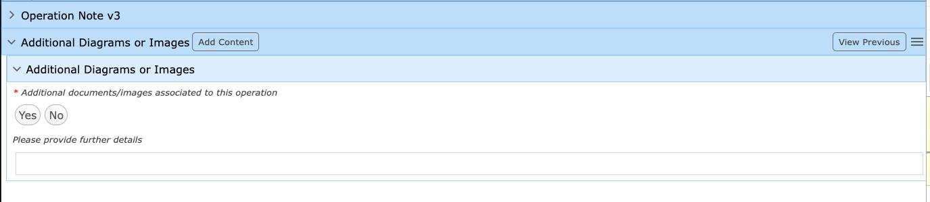
2
Operation Notes
If the operation note already contains post operative instructions, antibiotic, and VTE details, you can simply click ‘see operative note’
This avoids duplication, and allows the surgeon to use their preferred operative note templates and quick text
The Operative Log will pull information entered by theatre staff such as tourniquet times, operative blood loss, and implant details automatically
For procedures where images have been taken (e.g. Laparoscopy/Arthroscopy) complete the additional images section to ensure scanned documents are associated with the operation note
Use your PIN to sign the document

