Slide 1

Expanse access for Consultants
Notes:
What – Who – Where – How to do COGL comms
Talking about company/facility-wide: not workstream comms they are issuing to their stakeholder

Slide 2
Accessing Expanse
Accessing Expanse remotely from the 1st of November will be via Citrix or Citrix Web, you will need the following information:
Information | Description | Next Steps
Usernames | Expanse username ending @HCAconsultant.co.uk,@HCAhealthcare.co.uk,@HCA.uk.net @HCAcontractor.co.uk HCA device log in if using an HCA device (e.g. JSMITH) | If you do not know your details call the IT Service Desk - 0207 759 3737 or internally 23737. Press options 1 and 1 again. There is a call back feature. Or contact your primary facility.
Password | The same password you use to log into HCA devices/MFA/HCA email
Multifactor authentication (MFA) | Microsoft MFA application set up for HCA on your mobile | If you know your username and password but do not have MFA see the self-service guide If you cannot set up MFA please contact the IT service desk or your primary facility

Slide 3
Setting Up Multifactor Authentication (MFA)
You can set MFA up on your own using this self-service guide
To set up MFA you need your username and password
Do not hesitate to ask for help if you require assistance

Slide 4
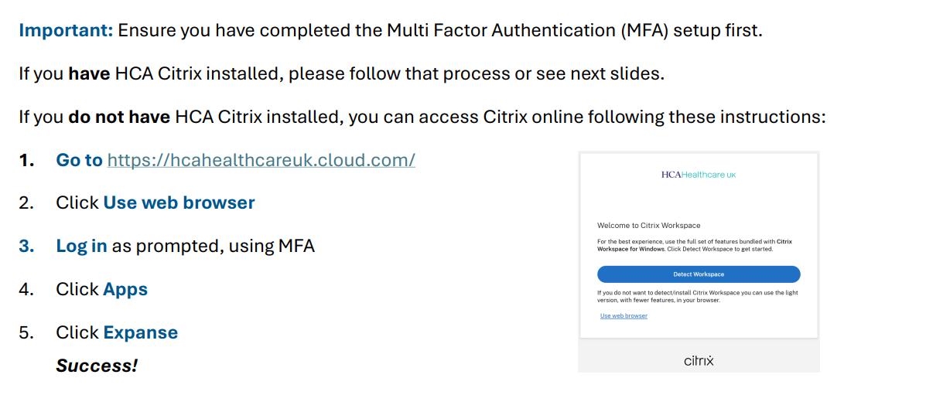
Accessing Expanse Remotely via Citrix Web
https://hcahealthcareuk.cloud.com/

Slide 5
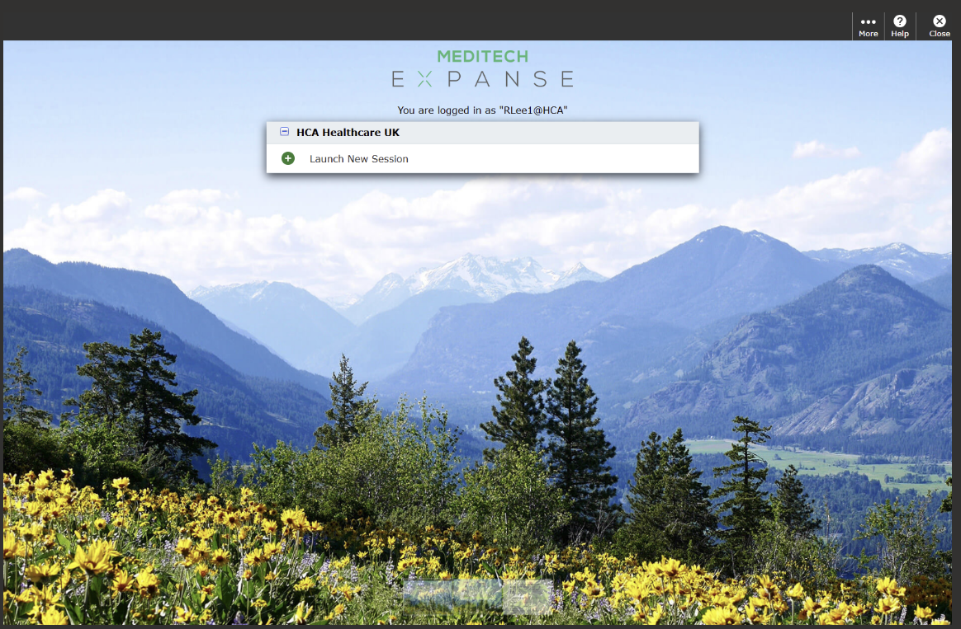
Launching Expanse
Click to launch a new session

Slide 6

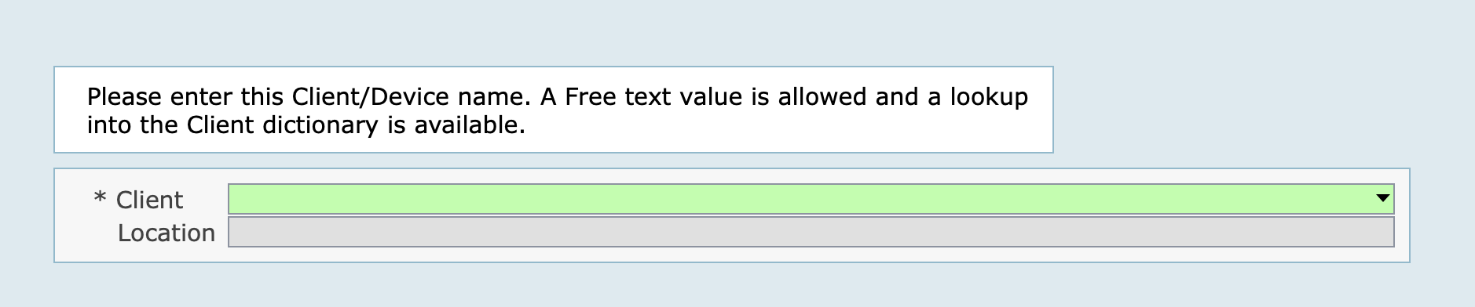
Launch New Session – set your HCIS
If you are asked to pick a HCIS – pick HCA
If asked for a 'Client' type in the associated green box 'laptop', then click 'save' in the bottom right corner of the overlay box

Slide 7
HCA Remote Access
A compact guide for Consultants to set up remote access on non-HCA computers

Slide 8
Content
Pages | Description (click the hyperlinks for ease of access)
9 – 11 | How to set up Multi Factor Authentication
12 | How to use Citrix on the web
13 | How to install Citrix on a non-HCA Windows computer
14 | How to install Citrix on a non-HCA Apple Mac computer
15 | How to use Citrix on your computer
16 | Login issues and IT Support

Slide 9

Multi Factor Authentication (1 of 3)
On your mobile device, install an app called Microsoft Authenticator. Had MFA set up on your old device but now have a new mobile? Refer to page 9 and call the ITG Service Desk who can reset your MFA to enable set up.
Open any web browser on your computer/secondary device. Copy and paste the following website into your browser’s address bar: aka.ms/mfasetup
Log into the Microsoft sign in page with your HCA email address and password. Important: After signing in, you may see the images as shown on steps 4 or 7. If so, proceed to the relevant step you see.
On the left of the screen, click Security Info
Click Add sign-in method then select Microsoft Authenticator
MFA app icon
3

Slide 10
Multi Factor Authentication (2 of 3)
Click Next then Next again to set up your account (the QR code should now appear)
On your mobile device, open the Microsoft Authenticator application
Press the + button at the top of the screen, then select the Work or school account option
Select Scan QR code, then scan the QR code that is on the computer/secondary device
Once scanned, click Next on the computer/secondary device
Enter the number that shows on the computer/secondary device into the notification box on the mobile device then press approve
4

Slide 11
Multi Factor Authentication (3 of 3)
On the computer/secondary device, click Next
Select Add sign-in method then select Phone
Change the Country code to United Kingdom
Enter your mobile number, choose either Receive a code or Call me then click Next If prompted, enter the Captcha characters.
Enter the code sent to your phone and click Next Success! You have now completed the Multifactor Authentication set up. This only needs to be performed once.
5

Slide 12
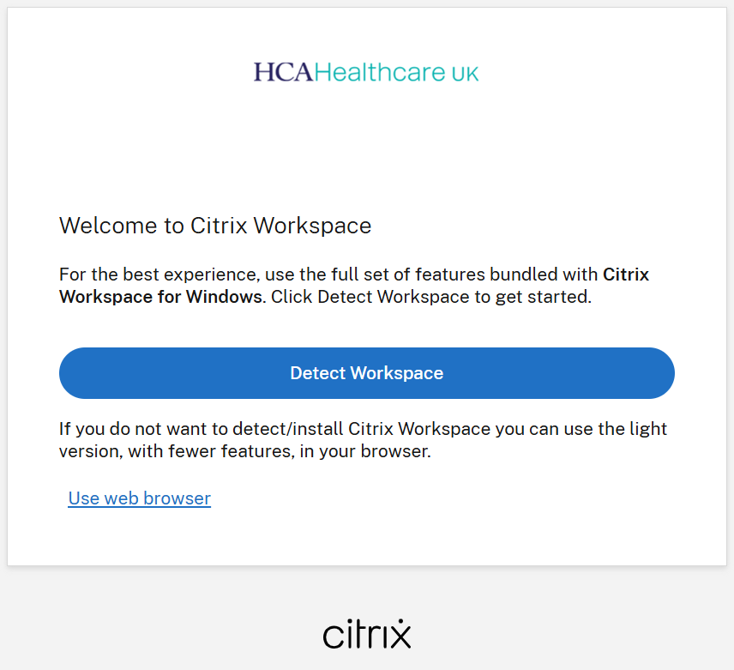
Citrix on the web
Important: Ensure you have completed the Multi Factor Authentication (MFA) setup first.
If you have HCA Citrix installed, please follow that process or see next slides.
If you do not have HCA Citrix installed, you can access Citrix online following these instructions:
Go to https://hcahealthcareuk.cloud.com/
Click Use web browser
Log in as prompted, using MFA
Click Apps
Click Expanse Success!
6

Slide 13
Installing Citrix on Windows
Important: Ensure you have completed the Multi Factor Authentication setup first.
Download Citrix Workspace by clicking here
Once downloaded, launch Citrix by searching it on your Windows Start Menu
When prompted to Add Account, enter hcahealthcareuk.cloud.com then click Add
Success! You have now completed the set up for Citrix. This only needs to be performed once. Refer to page 9.
7

Slide 14
Installing Citrix on Apple Mac
Important: Ensure you have completed the Multi Factor Authentication setup first.
Download Citrix Workspace by clicking here
Once downloaded, click on the CitrixWorkspaceApp.dmg file from the bottom right-hand corner of the screen
Click Install Citrix Workspace and continue through the prompts
Enter your Admin username and password then click Install Software
Tick Add Account then click Continue
When prompted to Add Account, enter hcahealthcareuk.cloud.com then click Add
Success! You have now completed the set up for Citrix. This only needs to be performed once. Refer to page 9.
8

Slide 15
Using Citrix Workspace
Launch Citrix Workspace
Enter your HCA email address, click Next
Enter your HCA password, click Sign in
Approve the sign in using MFA on your mobile
Click on Apps or Desktops to access what you need
9

Slide 16
Login Issues & Support
For HCA username or password login issues, and general HCA IT issues, call the ITG Service Desk on 0207 759 3737 or internally on 23737. Select Option 1 then Option 1 for dedicated Consultant support.
Disclaimer: This document was first published 2nd September 2025 and is controlled electronically. Printed copies of this document are not controlled. Document users are responsible for ensuring printed copies are valid prior to use.
10

