Slide 1
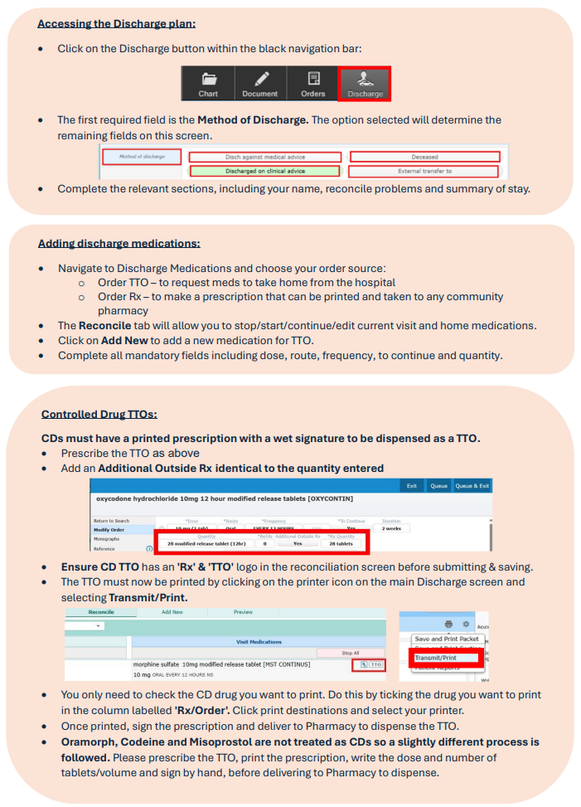
Home
Completing a TTO for a controlled drug
Click to return to menu page

